Slide 1
VÁMONOS 1-1
Hola Clase!
Seat quickly and silently and start answering the Vámonos questions.
Objetive: I can understand classroom commands
If you still did not turn in your three signed forms today, they are already due.
If you have job applications!! Give them to señora Lugo

Slide 2
EL OBJETIVO:
I can understand classroom commands vocabulary.

Slide 3
SU TAREA:
Review today’s vocabulary at least for 15 minutes using quizlet
www.quizlet.com
Mslugo
Piedmont 6th Spanish
Piedmont 8th Spanish
Piedmont 7th Spanish

Slide 4
Momento Cultural
Español es increíble porque…

Slide 5
IT’S THE FUTURE!!!
50.5
43%
The Hispanic population as of the 2010 Census…Hispanics are the largest minority group!
The percentage increase of Hispanics in the US from 2000 to 2010…WOW!
MILLION
132.8
2nd
The projected population of Hispanics in the US for July 1, 2050.
The 2nd most spoken language in the world!
MILLION

Slide 6
I guess we better learn some español!

Slide 7
Vocabulary / I can Statements
Buddy appointments

Slide 8
Homework Log

Slide 9
INM: Mandatos
Por favor, abre el libro a la página 4.
We are learning this because it will help me communicate with you in Spanish about day-to-day activities.
As I teach you these commands, please write down what they mean in English on your new packet vocabulary sheet.

Slide 10
Levanta la mano

Slide 11
Siéntate

Slide 12
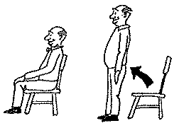
Levántate

Slide 13
Escucha

Slide 14
Escribe

Slide 15
Saca

Slide 16
Abre

Slide 17
Cierra

Slide 18
Dibuja

Slide 19
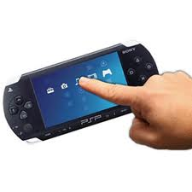
Toca

Slide 20
Señala

Slide 21
Silencio

Slide 22
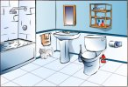
Puedo ir al baño?

Slide 23
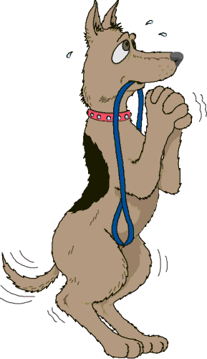
Por favor

Slide 24
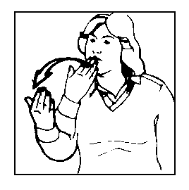
Gracias

Slide 25
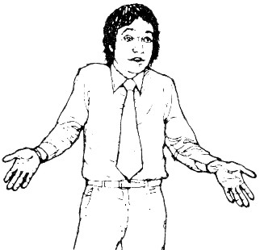
De nada

Slide 26
Disculpe

Slide 27
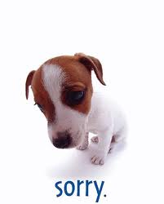
Perdón

Slide 28
Ve

Slide 29
Para

Slide 30
El lápiz

Slide 31
El cuaderno

Slide 32
El libro

Slide 33
El sacapuntas

Slide 34
La carpeta

Slide 35
El papel

Slide 36
Reflection
Fill out the reflection in your packet honestly and completely

Slide 37
GP: SIMÓN DICE…
We are going to play “Simon Says” in Spanish!
The Rules:
You should be at zero except for when you are saying a vocab. word. When you are saying a vocab. word, you should be at a seven and no higher.
Say the word as you do the motion.
Only do this when I say “Simón dice…”
If you do the wrong motion or say the wrong word, siéntate. You are out.
When you are out, you will be my eyes—if you see a classmate who should be out, look them in the eyes, give them a nod, and they will sit down.
If you are out, you must track those that are still playing, and repeat the command that Simon gives.

Slide 38
IP: LOS SCENARIOS
You will read several classroom scenarios. Based on the description of the situation, choose the SPANISH classroom command that would best fit. ESCRIBE the responses en español.

Slide 39
Las respuestas
Siéntate | 11. Cierra (el libro)
2. Levanta la mano | 12. Puedo ir al baño?
3. Saca (el papel) | 13. Escucha
4. Escribe | 14. Gracias
5. Dibuja | 15. De nada
6. Levántate | 16. Toca
7. Silencio | 17. Señala
8. Abre (el cuaderno) | 18. Por favor
9. Disculpa/perdón | 19. Disculpa/Perdón
10. Saca (el lápiz) | 20. No hay problema

Slide 40
Exit Ticket:
Abre el cuarderno. Below your Vamanos for the day, you will write Exit Ticket and number 1-5.
Below there are 5 mandatos in English. ESCRIBE the spanish commands en español without your notes.
Take out
Stop
Please
Excuse me
Write

Slide 41
Check Yo’self:
Switch with a partner and grade their exit ticket. Put the grade in the ‘E’ box that you created at the beginning of class.
Example: 5/5 = 100%
4/5 = 80%
3/5 = 60%
2/5 = 40%
Take out- Saca
Stop - Para
Please – Por favor
Excuse me – Disculpe OR perdón
Write - Escribe

