Slide 1
Vámonos: TIENEN 5 MINUTOS Unit 2: El alfabeto y la pronunciación
Objective:
I can greet someone or say goodbye, I can sing the alphabet.
Vocab/Ideas:
El alfabeto
CH
LL
Ñ
RR
Vámonos:
Next Slides

Slide 2
VÁMONOS
Translate the following sentences from Spanish into English.
1) ¿Cómo te llamas?
2) Me llamo Kobe.
3) Buenas tardes, Señorita Lugo.
4) Hasta luego, Señora Barone.
5) Buenas noches, Papá.
6) Hola, chica.
7) El es de Colombia.
8) Nosotros somos de Caracas, Venezuela.
What is your name?
My name is Kobe.
Good afternoon, Mrs. Lugo.
See you later, Mrs. Barone.
Good night, Dad.
Hello, girl.
He is from Colombia.
We are from Caracas, Venezuela.

Slide 3
Direcciones: For each of the following situations, write the SPANISH greeting or farewell that would be most appropriate.
Your alarm clock just went off, and your mom walks in to ensure that you’re up and moving. To greet her, you would say:
You run in to your Spanish teacher at Target at 9:00PM. What do you say?
You’re with your friends, and your mom texts you that you need to come home for dinner. You tell your friends, “see you later.” You’d say:
Lunch is over and you’re on your way to Spanish class. To greet your teacher, you’d say:
It’s your little brother’s bedtime. To tell him “good night,” you’d say:
To say “hello” to your best friend at any time of the day, you would say:
It’s finally Friday! To bid farewell to your friends and teachers, you would say ______________________________! Que tengan un buen fin de semana (Have a good weekend)
Buenas noches
Buenos días
Hola
Buenas noches
Adiós
Hasta luego
Buenos tardes

Slide 4
EL OBJETIVO
I can greet someone or say goodbye, I can sing the alphabet.

Slide 5
TAREA
Practice your pronunciation boxes that were handed out in class for at least 15 minutes!
Practice the alphabet song

Slide 6
http://www.youtube.com/watch?v=ngRq82c8Baw
MOMENTO CULTURAL
Spanish Love Song:
Look what you are going to be able to do and understand at the end of the class
Notes:
http://www.youtube.com/watch?v=ngRq82c8Baw

Slide 7
INM: El ALFABETO

Slide 8
El alfabeto
Spanish is a PHONETIC language.
This means that it is spelled the way it sounds—unlike English.
Ex. Telephone vs. teléfono
It has 4 EXTRA letters because it’s EXTRA awesome!
Ch
Ll
Ñ
Rr

Slide 9
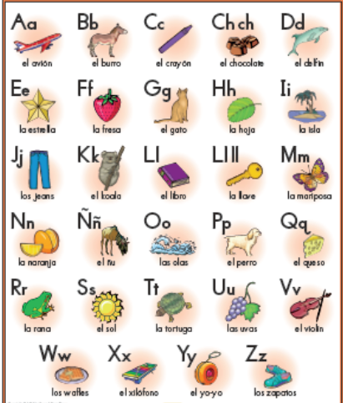
Each letter has a word in Spanish that exemplifies its sound…let’s practice saying the words!

Slide 11
GP: LA CANCIÓN DEL ALFABETO!!!
You are going to sing.
And you are going to love it.
(Es una competencia!)
Primera vez
Segunda vez
Tercera vez
Notes:
http://www.youtube.com/watch?v=JUcu9PUh9_A
1st time just have students listen
2nd time have students listen and look at the page in their books as they follow along
3rd time have students try to sing along

Slide 12
INM: PRONUNCIACIÓN
http://srkennedy.podbean.com/ - Boxes 1-4

Slide 14
IP: Alfabeto
Foldable

