Slide 1
VÁMONOS 1-2 *TIENES 5 MINUTOS*
Objective:
I can describe different reasons for studying Spanish
Vocab/Ideas:
Reasons to study Spanish
Vámonos:
Can you think of five US cities that have Spanish names?
Describe a situation where you would need to be able to introduce yourself to new people.
What do you think is the most used language in the world? What place is Spanish ranked?

Slide 2
Vámonos Respuestas!
San Antonio, Los Angles, Santa Fe, El Paso, San Francisco…
First day of…school, work, camp, class, etc.
3. Chinese (Mandarin) is ranked 1st and Spanish is ranked 3rd. English is ranked 2nd. and French is the 13th.

Slide 3
VÁMONOS 1-1
TIENES 5 MINUTOS*
Objective:
I can describe different reasons for studying
Spanish
Vámonos :Vocab/Ideas:
Classroom expressions from green sheet (use your green sheet to fill in the vocab/ideas in your packet)
Vámonos:
In your packet on the section that says “Vocabulario Extra”, write at least 5 words/phrases in English that you would like to learn in Spanish

Slide 4
Let’s know each other better

Slide 5
EL OBJETIVO:
I can describe different reasons for studying Spanish.

Slide 6
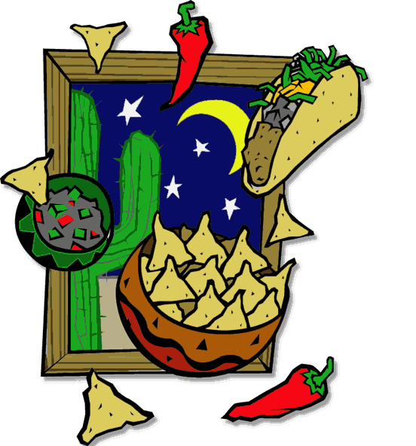
So we’re supposed to learn Spanish…
But what’s the big deal? Why should I care? What’s Spanish got to do with me?
Notes:
https://www.youtube.com/watch?v=pQnhuj11zgI&authuser=0

Slide 7
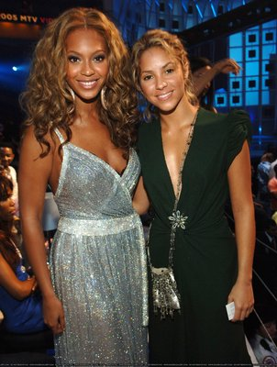
Beyonce and Alicia Keys are even joining in!
Beyonce sang a Spanish version of “Irreplaceable” that was such a hit on the Latin charts, she re-released her album B’day with 6 tracks sung in Spanish! She also teamed up with Shakira (who is from the Latin American country of Colombia) to record “Beautiful Liar.”
Alicia Keys teamed up with Spanish artist Alejandro Sanz to sing the popular song, “Looking for Paradaise.”

Slide 8
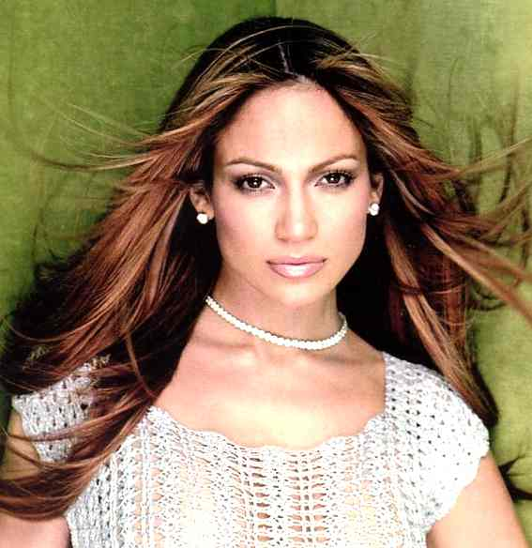
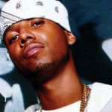
Some of your favorite celebrities come from Hispanic backgrounds…
Pitbull (Cuban)
Eva Mendes (Cuban)
Lloyd Banks (Puerto Rican)
Christina Aguilera (Ecuadorian)
Jennifer Lopez (Puerto Rican)
Daddy Yankee (Puerto Rican)
Juelz Santana (Dominican)
Jessica Alba (Mexican)

Slide 9
INM: Reasons for studying Spanish

Slide 10
Reason #1: College!
Did you know?
Many four year universities now require (or at least prefer) that you take 2 years of a foreign language in high school.
What’s the big deal about college?
It’s a door opener

Slide 11
Reason #2: Communication

Slide 12
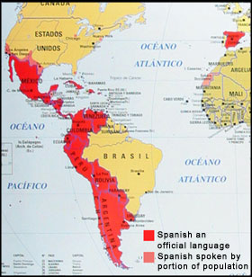
These are only a few of
over 400 million Spanish speakers in the world!
Countries whose official language includes Spanish are colored red (21).

Slide 13
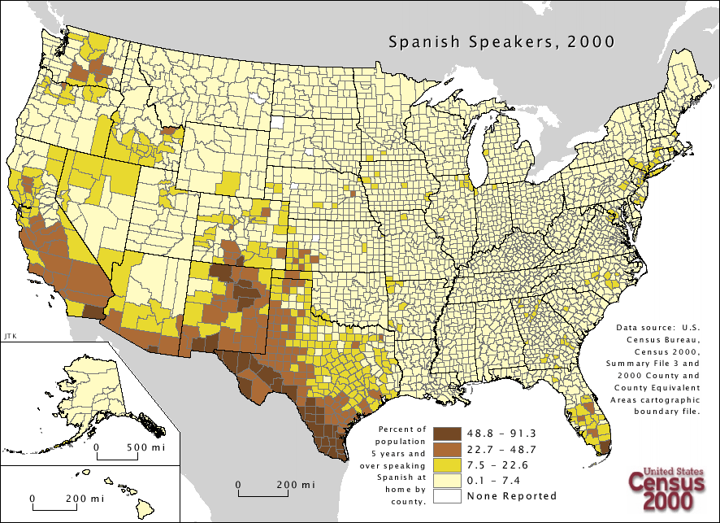
In the United States alone, there are over 40 million Spanish speakers

Slide 14
Reason #3: Other Classes
Spanish is a Romance language that comes from Latin. So knowing Spanish will help in classes like anatomy, or if you plan on working in the medical field.
Many Spanish words are cognates, and can help you improve your vocabulary in English. This will help you to improve your scores on tests like the SAT.
2 years of foreign language = 110 points higher!

Slide 15
Reason #4: Better Job and More $$$$

Slide 16
There are great benefits to being bilingual!
Give yourself job security by having a valuable skill- speaking two languages!
Bilingual people are more marketable and have more career choices (and can make more money!)- as an interpreter, teacher, translator, reporter, tour guide, flight attendant, social worker… the list goes on!
Bilingual people makes 15-20% more on average
In the business world: Sell your product or service to over 35 million Spanish speakers in the U.S., and to over 300 million people worldwide

Slide 17
There are great benefits to being bilingual!
Do well in this class to test out of Spanish classes in college, saving yourself time and tuition money.
BILINGUAL individuals are more marketable in the job world and have more career choices (and can make more money) as an interpreter, teacher, translator, reporter, tour guide, flight attendant, social worker, etc…

Slide 18
In any job, knowing Spanish can open the door to more opportunities…
“I work for a public relations firm, so I pitch ideas to television stations and newspapers throughout Chicago.
I wish I knew Spanish, because without it I am unable to share stories with any of the Spanish TV stations or Spanish papers in the city.
I have to leave that up to my bilingual coworkers.”
--Kelcy Hale, monolingual

Slide 19
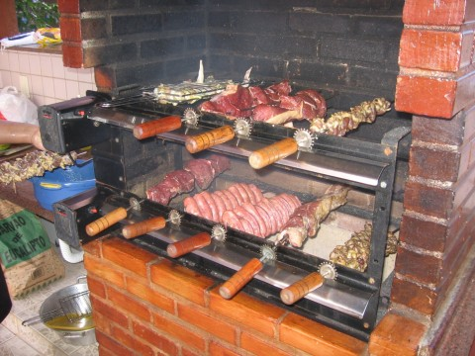
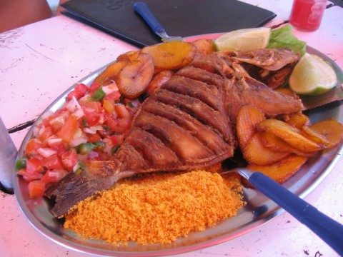
Reason #5: While learning a new language, you will also learn about new cultures…
Try their FOOD!

Slide 20
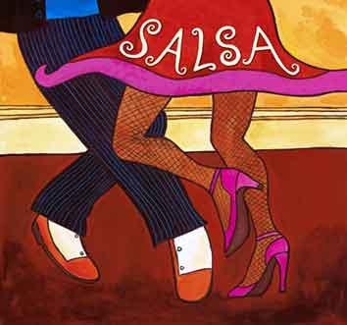
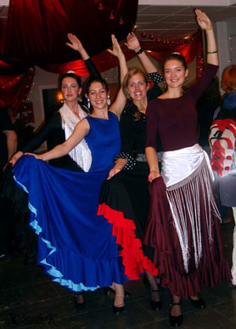
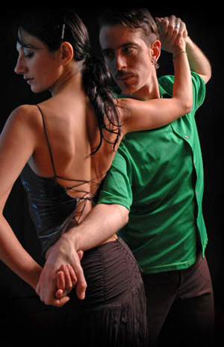
And learn their DANCES!
Flamenco!
Tango!
Notes:
https://www.youtube.com/watch?v=s-0R_q89UTo

Slide 21
It’s your turn! A Leer
Take out your book and turn to Page XVI
Preguntas para página XVI
How many countries use Spanish as the official language?
What regions of the world is Spanish spoken in?

Slide 22
A Leer. p. xvii
Preguntas para página XVII
Tell what the following people were known for:
Miguel de Cervantes
Isabel Allende
Fernando Botero
Frida Kahlo
Gabriela Mistral
Pablo Neruda
Said Musa
4. Who was the Fountain of Cibeles named after?

Slide 23
A Leer. p. xviii.
Preguntas para página XVIII
About how many Spanish speaking people live in the United States?
What kinds of employers will be looking for bilingual workers in the future?

Slide 24
A Leer. p. xix.
Preguntas para página XIX
What are some ways YOU could communicate with Spanish speakers?
Where are they bicyclists in the photo on page xix? How would YOU describe that city based on how its buildings look?

Slide 25
PROCEDURES THE LITTLE THINGS ARE THE BIG THINGS!
Group Work
We are a team, and because we are a team we will work together often
When I say that we will be working in groups, the first thing you need to do is listen for complete directions
If those directions are unclear, ask questions using our hand-raising procedure
During group work, the volume is at a 2 and I will play music
If volume gets above a 2, our group work will end and we will do our work independently at a zero
When the music starts…
When the music stops…
Practicamos!

Slide 26
Discutir!
It is time to discuss the reading with a friend.
Make sure that your friend has the answers to all of the questions from class- remember it is important to write in complete sentences!
Discuss what you think are the best and worst reasons to study Spanish
With your friend, create a list of the 5 most important reasons to study Spanish

Slide 27
Start in Class/Tarea
You are to create a mini poster to represent YOUR GROUP’S reasons for taking Spanish.
Draw pictures to represent things that motivate you and things that you hope to accomplish in your life by learning Spanish.
Posters should be colorful and well presented. They should not contain just lists of words, but images that represent your ideas. Your final product will be presented and will be put into your Spanish folder as one of your first entries.

Slide 28
It’s Your Turn!
With your partner, create a one-page advertisement that explains why it’s important to study Spanish.
Use what you learned today
I will put the best ads up on our bulletin board!
Start looking for opportunities to use Spanish in your everyday life.

