Slide 1
Vámonos: TIENEN 5 MINUTOS
Objective:
I can sing the alphabet, I can spell a word when I hear it spelled in Spanish, I can pronounce sounds in Spanish
Vocab/Ideas:
El alfabeto (review)
Sounds of letters versus names of letters
Vámonos:
1.What are the four “extra” letters in the Spanish alphabet? How do you say the four letters?
2.What does it mean that the Spanish alphabet is a phonetic language? Explain yourself in at least one complete sentence.

Slide 2
TAREA / Homework
PRACTICE, PRACTICE
Practice boxes for at least 15 minutes total using the link on the web page 1-8.
Don’t forget to practice the alphabet song.

Slide 3
EL OBJETIVO
I can spell a word when I hear it spelled. I can pronounce sounds in Spanish.

Slide 4
MOMENTO CULTURAL
A Spanish Tower of PEOPLE!

Slide 5
This year, in the beginning of October, the Cataluña region of Spain will host the 25th Annual Tarragona Castells Competition. This is a cultural phenomenon in which groups called "colles" compete to build the highest, most unique human towers. It is a true demonstration of community, trust, skill and training.
The people who participate in these teams are called "castellers," and they continually attempt to build the highest, most complex human towers using ever-evolving techniques. The Catalan tradition is believed to have originated from human towers built at the end of the 18th century by dance groups, and it has morphed into an integral part of the Catalan culture.
Watch the video and see how the tower builders walk over the supportive crowd just to get to the site. Then, they naturally begin with the big men on the lower tiers and keep constructing upward to the young children on top. Each tier of people climbs up on the shoulders of the lower tiers. May all people learn to trust our neighbors as these community members are doing. And may we build new global communities where all members are supported, just as happen each year in Spain with these human towers.
Notes:
http://vimeo.com/16392519

Slide 6
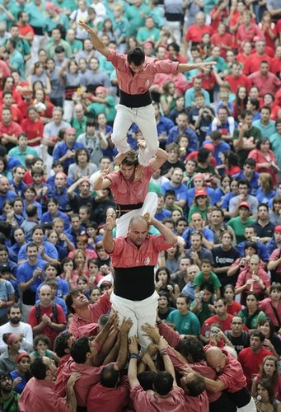
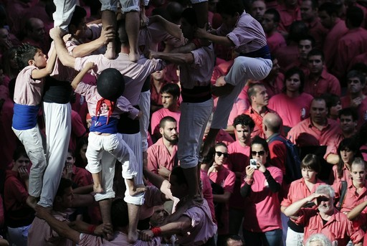
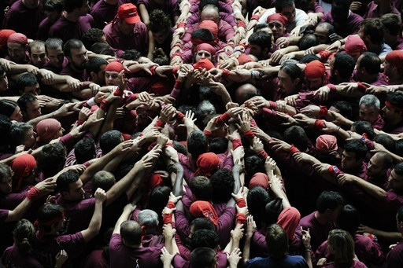

Slide 7
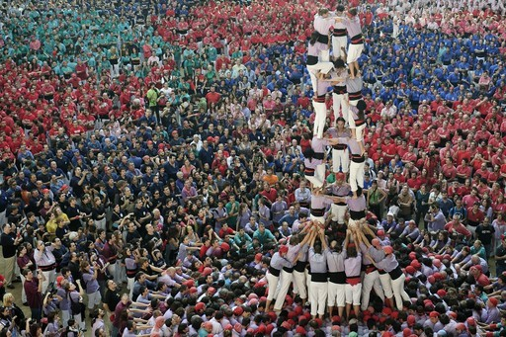

Slide 8
MOMENTO CULTURAL
Vamos a ESPAÑA…

Slide 9
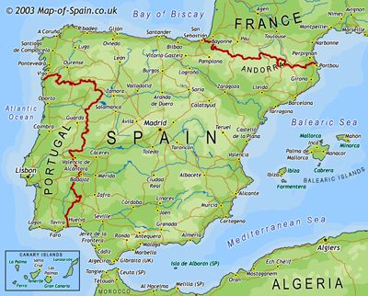
GEOGRAPHY OF SPAIN
Spain occupies 85% of the Iberian Peninsula, which it shares with Portugal in southwest Europe. Spain borders with France to the northeast.
In southern Spain, one can look across the Strait of Gibraltar and see Morocco in Africa! African culture has a huge influence in southern Spain.
Spain has 17 regions that have political autonomy (think: states), and two groups of islands. It is sandwiched between two continents (Africa and Europe).
Balearic
Islands
Canary
Islands
AFRICA

Slide 10
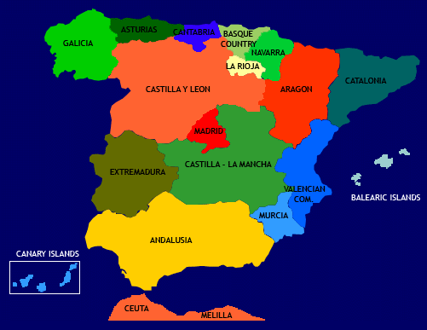
REGIONS OF SPAIN

Slide 11
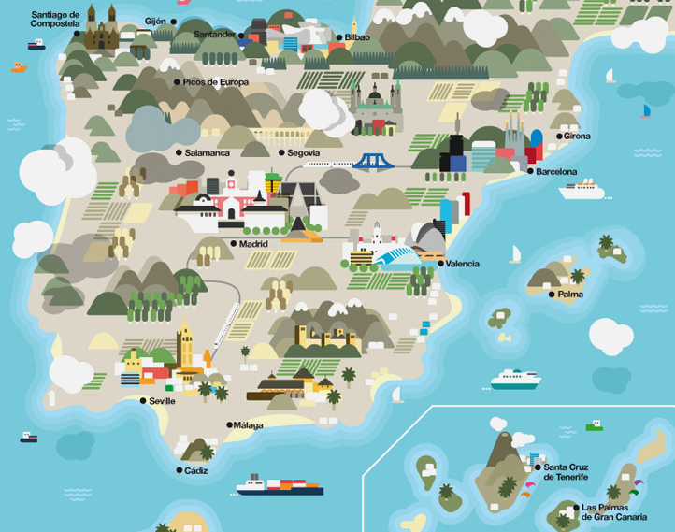
Notes:
Point out the major cities: Madrid (capital), Barcelona (big artistic city), Santiago de Compostela (religious significance), Sevilla (birth of flamenco), etc. Also pint out the varied geography (in the north, many more mountains, in the south a much hotter climate, visible with the palm trees)

Slide 12
Foldable-El Alfabeto

Slide 13
EL ALFABETO

Slide 15
EL ALFABETO
http://www.youtube.com/watch?v=JUcu9PUh9_A

Slide 16
INM: El Alfabeto (pronunciacion)

Slide 17
Pronunciation
What is the difference between the Spanish and English “t” sound? How does “t” sound in Spanish?
The letter “c” is a hard “c” when followed by what vowels?
The Spanish “t” is not sharp and sounds more like the English “d” sound
O
A
U

Slide 18
¡PIZARRITAS!
I will first tell you how many letters are in the word so that you can draw that many blanks.
Then I will spell the word letter by letter in Spanish.

Slide 19
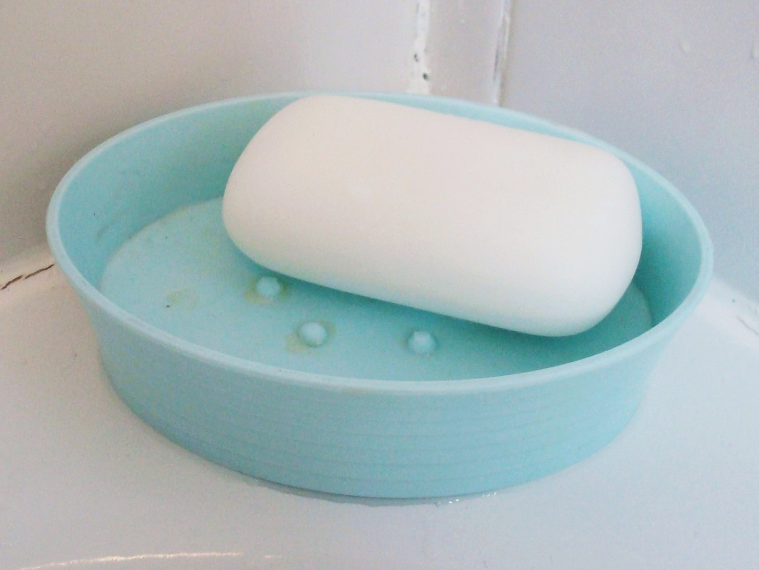
1. JABÓN

Slide 20
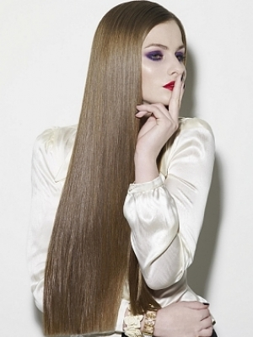
2. LARGO

Slide 21
3. NARIZ

Slide 22
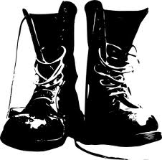
4. BOTAS

Slide 23
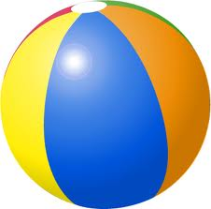
5. PELOTA

Slide 24
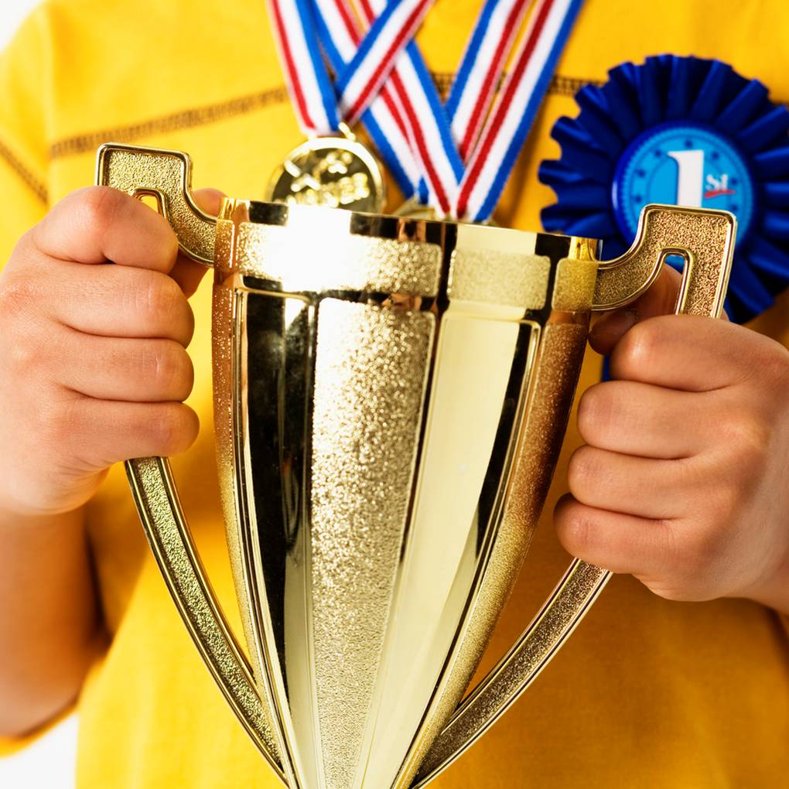
6. CAMPEÓN

Slide 25
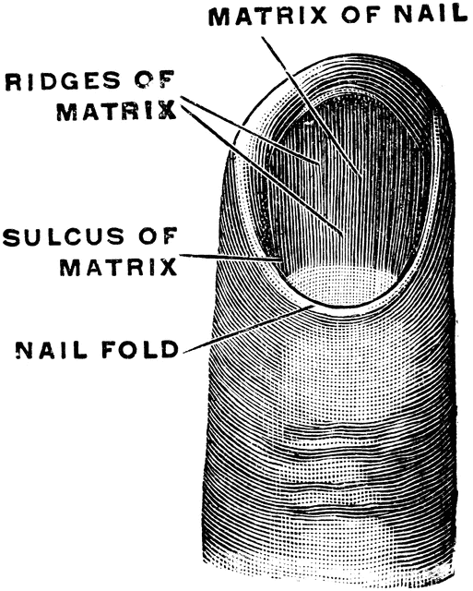
7. UÑA

Slide 26
8. CHARRO

Slide 27
9. Lapiz

Slide 28
10. Carpeta

Slide 29
PRONUNCIACIÓN
http://srkennedy.podbean.com/ - Boxes 5-8

Slide 31
GP: CÓMO SE ESCRIBE?
With your partner, you will be working on writing the words based on the pronunciation. Remember, Spanish is phonetic! USE YOUR GUIDE!!!
You have 5 minutes.

Slide 32
¿Cómo se escribe?
Direcciones: Your friend Mara is teaching you how to write words in Spanish. Based on her pronunciation, write the word in Spanish. Then, guess what the words mean in English.
1. She says: “Hey, ee, em-may, en-nay, ah, es-say, ee, oh.”
You write: __________________________________
You think it means: _________________________
2. She says: “Oh, eff-ay, ee, say, ee, en-nay, ah.”
You write: __________________________________
You think it means: _________________________
3. She says: “Set-a, eh, bay, er-ray, ah.”
You write: __________________________________
You think it means: _________________________
4. She says: “Ah-chay, ah, em-may, bay, ooo, er-ray, hey, ooo, eh, es-say, ah.”
You write: __________________________________
You think it means: _________________________
gimnasio
gymnasium
oficina
office
zebra
zebra
hamburguesa
hamburger

Slide 33
Cancion: La Mar estaba serena
https://www.youtube.com/watch?v=YtCBGYcS_LU

Slide 34
Salida / Exit Ticket
1. Write the letters that are in the Spanish alphabet but are not included in the English alphabet.
1.
2.
3.
4.
2. Mention the Spanish Vowels

