Slide 1
Vámonos: TIENEN 5 MINUTOS
Objective:
I can sing the alphabet, I can spell a word when I hear it spelled in Spanish, I can pronounce sounds in Spanish
Vocab/Ideas:
El alfabeto (review)
Sounds of letters versus names of letters (review)
Vámonos:
What is the difference between the Spanish and English “t” sound? How does “t” sound in Spanish?
The letter “c” is a hard “c” when followed by what vowels?

Slide 2
VÁMONOS
What is the difference between the Spanish and English “t” sound? How does “t” sound in Spanish?
The letter “c” is a hard “c” when followed by what vowels?
The Spanish “t” is not sharp and sounds more like the English “d” sound
O
A
U

Slide 3
MOMENTO CULTURAL
A Spanish Tower of PEOPLE!

Slide 4
This year, in the beginning of October, the Cataluña region of Spain will host the 25th Annual Tarragona Castells Competition. This is a cultural phenomenon in which groups called "colles" compete to build the highest, most unique human towers. It is a true demonstration of community, trust, skill and training.
The people who participate in these teams are called "castellers," and they continually attempt to build the highest, most complex human towers using ever-evolving techniques. The Catalan tradition is believed to have originated from human towers built at the end of the 18th century by dance groups, and it has morphed into an integral part of the Catalan culture.
Watch the video and see how the tower builders walk over the supportive crowd just to get to the site. Then, they naturally begin with the big men on the lower tiers and keep constructing upward to the young children on top. Each tier of people climbs up on the shoulders of the lower tiers. May all people learn to trust our neighbors as these community members are doing. And may we build new global communities where all members are supported, just as happen each year in Spain with these human towers.
Notes:
http://vimeo.com/16392519

Slide 5
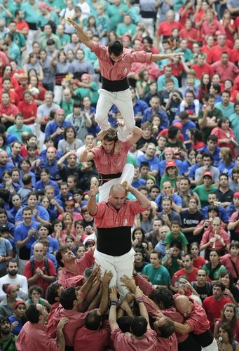
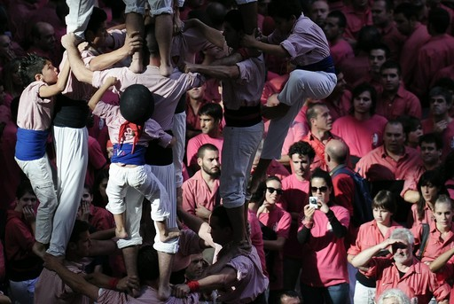
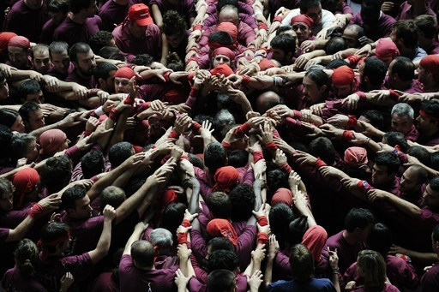

Slide 6
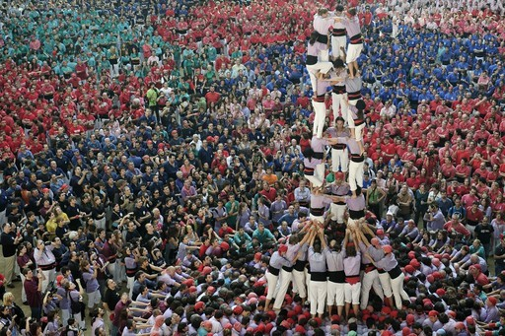

Slide 7
EL ALFABETO
http://www.youtube.com/watch?v=JUcu9PUh9_A

Slide 8
IP: LISTENING SPELLING-BEE!!! Pronunciation Practice
página 45.
Escucha while I say a word twice.
I will first tell you how many letters are in the word so that you can draw that many blanks.
Then I will spell the word letter by letter in Spanish
Hot Seat Option: Is anyone CONFIDENT enough to spell their words in front of the whole class???

Slide 9
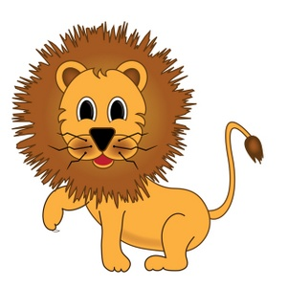
LEÓN
1.

Slide 10
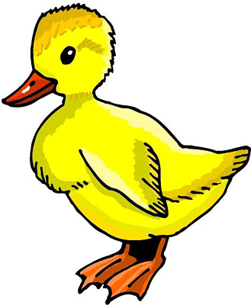
PATO
2.

Slide 11
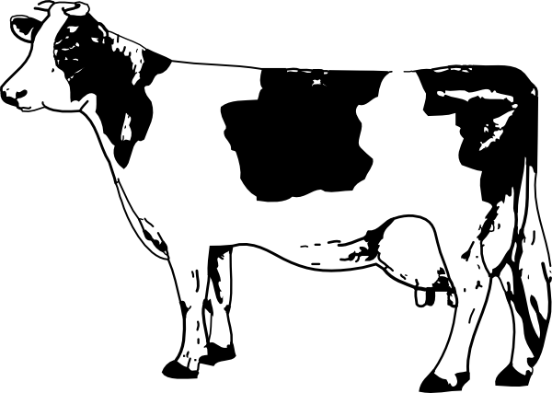
VACA
3.

Slide 12
ROJO
4.

Slide 13
UNO
5.
1

Slide 14
ESPAÑA
6.

Slide 15
MÉXICO
7.

Slide 16
CAFÉ
8.
L

Slide 17
GRIS
9.
L

Slide 18
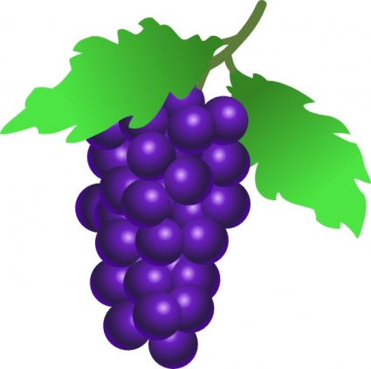
UVAS
10.

Slide 19
PARTNER GAME!
We will be playing hangman with partners.
When I say “go”, find a partner.
You will take turns spelling words out loud in Spanish and trying to guess your partner’s words.
Notes:
http://www.wikihow.com/Play-Hangman

Slide 20
PRONUNCIACIÓN
http://srkennedy.podbean.com/ - Boxes 9-11

Slide 23
Cancion: La Mar estaba serena

Slide 24
TAREA
Practice the alphabet for your SPELLING TEST next class! Use the video (Spelling Practice on the web page)
Remember, your carpeta and your homework log are also due NEXT CLASS!

Slide 25
Exit Ticket / Quiz
Escucha while I say a word twice. The first time, write down the word, the second time, check your work!
SI, SE PUEDE

