Slide 1
Vámonos: TIENEN 5 MINUTOS
Objective:
I can sing the alphabet, I can spell a word when I hear it spelled in Spanish, I can pronounce sounds in Spanish
Vocab/Ideas:
El alfabeto (review)
Sounds of letters versus names of letters (review)
Vámonos:
Get a whiteboard ( pizarra y marcador for a listening practice

Slide 2
MOMENTO CULTURAL

Slide 3
EL ALFABETO
http://www.youtube.com/watch?v=JUcu9PUh9_A

Slide 4
GP: LISTENING Practice
Pág 23- Actividad 29

Slide 5
Group Practice
Actividad 30 pag 23

Slide 6
PRONUNCIACIÓN
http://srkennedy.podbean.com/ - Boxes 9-11

Slide 7
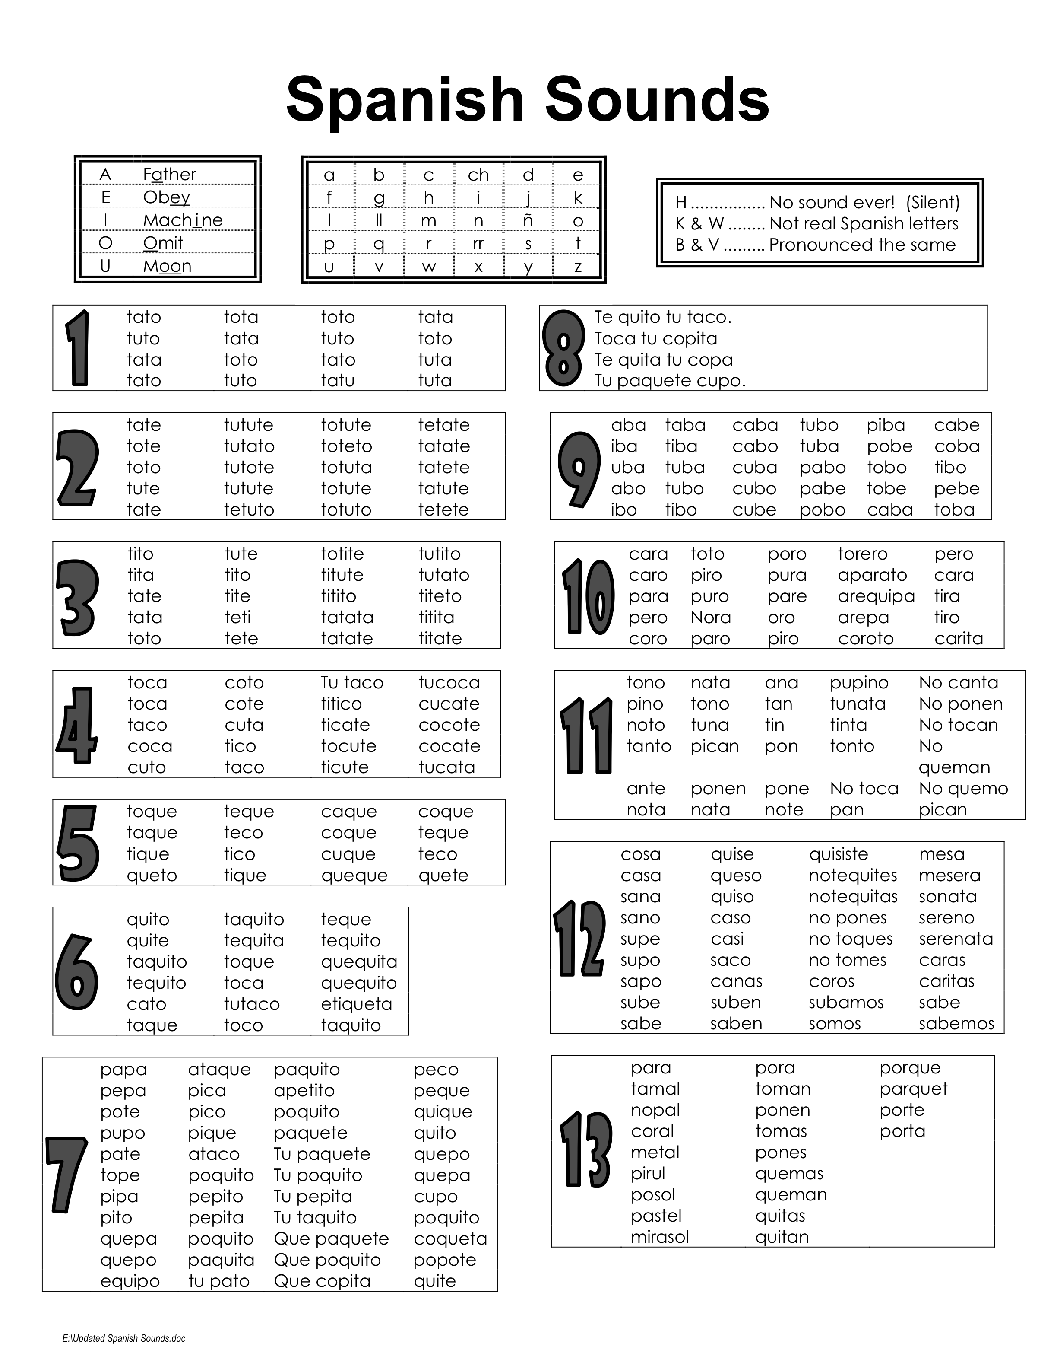

Slide 9
Cancion: La Mar estaba serena

Slide 10
TAREA
Practice the alphabet for your SPELLING TEST next class! Use the video (Spelling Practice on the web page)
Remember, your homework log is also due NEXT CLASS!

Slide 11
Exit Ticket / Quiz
Escucha while I say a word twice. The first time, write down the word, the second time, check your work!
SI, SE PUEDE

