Slide 1
Vámonos: 3-2
TIENEN 5 MINUTOS
Objective:
  I can say the days of the week and months of the year and identify numbers 1-31 in Spanish
Vocab/Ideas:
  Numbers 11-31
  Numbers 1-10 (review)
  Days of the week (review)
  Months of the year (review)
Vámonos:
  Translate the following phrases/
  sentences into Spanish:
I have three pencils.
I need six pens.
Do you have four papers?
Do you need nine pencil sharpeners?
Take
Out your
Homework

Slide 2
VÁMONOS
I have three pencils.
I need six pens.
Do you have four papers?
Do you need nine pencil sharpeners?
Yo tengo tres lapices.
Yo necesito seis bolígrafos.
¿Tienes cuatro papeles?
¿Necesitas nueve sacapuntas?

Slide 3
ANUNCIOS
Quarterly Test
Wednesday October 22-B day
Tuesday October 21-A day

Slide 4
MOMENTO CULTURAL:
Corrida de Torros—España
Today we’re going to talk about BULLFIGHTING!

Slide 5
LA CORRIDA DE TOROS
While many people think that corrida de toros or bullfighting is a “bloody” sport, it actually has its roots in ancient religious ceremonies
The killing of the bull was actually seen as a sacrifice in the Mithraic religion, an ancient belief system of the Roman Empire
Today, corrida de toros is present in Spain’s neighbors, Portugal and France, and in many Latin American countries
Even so, it remains a very controversial sport
Look at the following images and tell me if you would want to attend a corrida de toros
(I’ve actually been to one, so I’ll tell you about that after!)

Slide 6
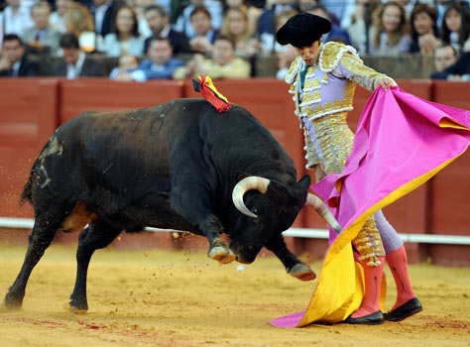
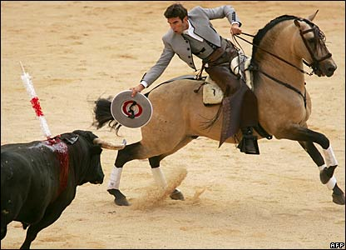
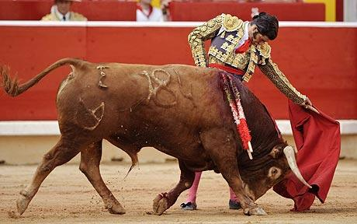
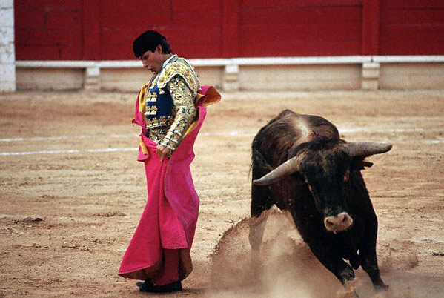
LA CORRIDA DE TOROS
Notes:
Video: http://www.youtube.com/watch?v=rbf5tuYUFwc&feature=fvsr

Slide 7
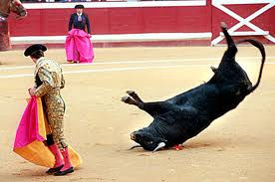
Una corrida de toros—de verás!
Video: http://www.youtube.com/watch?v=rbf5tuYUFwc&feature=fvsr

Slide 8
Repaso
Días de la semana
Meses del año
Números 1-10
!

Slide 9
NÚMEROS 11-20
NUMBERS 11-20
As each of the numbers pops up, write the Spanish word that matches the English on your packet.
Make sure to pay attention to spelling and accents!

Slide 10
11
once

Slide 11
12
doce

Slide 12
13
trece

Slide 13
14
catorce

Slide 14
15
quince

Slide 15
16
dieciséis

Slide 16
17
diecisiete

Slide 17
18
dieciocho

Slide 18
19
diecinueve

Slide 19
20
veinte

Slide 20
REPASO RÁPIDO
Quick Review

Slide 21
Quick Review
13
16
11
19
12
20
18
14
15
17
trece
dieciséis
once
diecinueve
doce
veinte
dieciocho
catorce
quince
diecisiete

Slide 22
NÚMEROS 21-31
NUMBERS 21-31
As each of the numbers pops up, write the Spanish word that matches the English on your calendar.
Make sure to pay attention to spelling and accents!

Slide 23
21
veintiuno
5

Slide 24
22
veintidós
5

Slide 25
23
veintitrés
5

Slide 26
24
veinticuatro
5

Slide 27
25
veinticinco
5

Slide 28
26
veintiséis
5

Slide 29
27
veintisiete
5

Slide 30
28
veintiocho
5

Slide 31
29
veintinueve
5

Slide 32
30
treinta
5

Slide 33
31
treinta y uno
5

Slide 34
REPASO RÁPIDO
Quick Review

Slide 35
Quick Review
28
22
24
29
21
30
27
26
31
23
25
veintiocho
veintidós
veinticuatro
veintinueve
veintiuno
treinta
veintisiete
veintiséis
treinta y uno
veintitrés
veinticinco

Slide 36
El Projecto

Slide 37
INM: LA FECHA
How to express the date in Spanish

Slide 38
La Fecha:
To express the DATE, use the following formula:
Hoy es el ______ de _________, 2011
(#) (month)
MODELO: Hoy es el 4 de julio, 2014
YOU TRY:
March 21
Hoy es el veintiuno de marzo

Slide 39
GP: A practicar

Slide 40
Pizarritas
For this next activity each student will need a whiteboard, eraser, and marker.
If you do not have a marker, you can do the activity on paper
Rules for Pizarritas:
ONLY write on the board when you are writing an answer. If you are found “doodling,” you will lose the privilege to use the pizarrita and will complete the activity on paper (it will be collected at the end of class).
Erase your answer completely after each question
Hold your board high in the air when I say “3-2-1-demuestrame!” (3-2-1 show me!)
Treat all materials respectfully
You will be shown a picture that will remind you of a date we ALL know. Write the date in Spanish!
Extension: If you finish early, take out your agenda and write the day of the week of the holiday showing on the board this year!

Slide 41

Ejemplo:
(March 17^{th)}
el diecisiete de marzo

Slide 42

El catorce de febrero

Slide 43

El veinticinco de diciembre

Slide 44
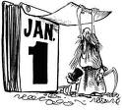
El uno de enero

Slide 45
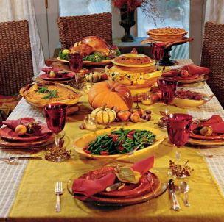
(November 27th)
El veintisiete de noviembre

Slide 46
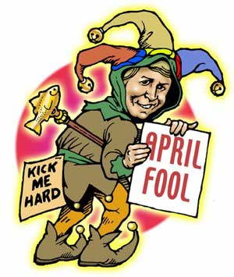
El primero de abril

Slide 47

El treinta y uno de octubre

Slide 48
Los números
You have 47 seconds to look at the screen and memorize all of the numbers that are there.
I will take ONE number away, and you need to tell me EN ESPAÑOL what number that is.
We will be using… PIZARRITAS!!!
You will write the number EN ESPAÑOL on your whiteboard.

Slide 49
14
16
10
25
8
19
23
27
12
5
31

Slide 50
14
16
10
25
8
23
27
12
5
31

Slide 51
19
diecinueve

Slide 52
14
16
10
25
8
19
23
27
5
31

Slide 53
12
doce

Slide 54
14
16
10
8
19
23
27
12
5
31

Slide 55
25
veinticinco

Slide 56
14
16
10
25
19
23
27
12
5
31

Slide 57
8
ocho

Slide 58
14
16
10
25
8
19
23
12
5
31

Slide 59
27
veintisiete

Slide 60
14
16
10
25
8
19
23
27
12
5

Slide 61
31
treinta y uno

Slide 62
14
16
25
8
19
23
27
12
5
31

Slide 63
10
diez

Slide 64
16
10
25
8
19
23
27
12
5
31

Slide 65
14
catorce

Slide 66
14
16
10
25
8
19
27
12
5
31

Slide 67
23
veintitrés

Slide 68
14
10
25
8
19
23
27
12
5
31

Slide 69
16
dieciséis

Slide 70
TAREA
Make sure you are studying.
REMEMBER: Your QUARTERLY will be Tuesday October 21st ADay) or Wednesday OCTOBER 22st (B Day). The quarterly will test your knowledge of:
Classroom Commands (Sit down, stand up, take out, etc)
Numbers 1-31
Days of the week
Months of the year
Greetings

Slide 71
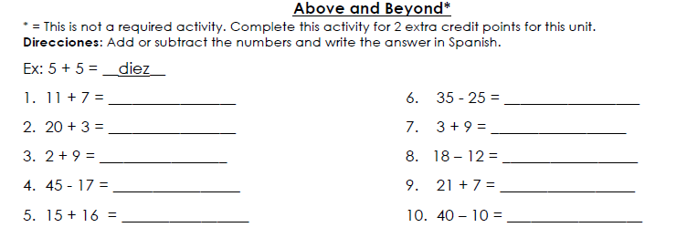
EXIT TICKET
dieciocho
diez
veintitrés
doce
once
seis
veintiocho
veintiocho
treinta y uno
treinta

