Slide 1
Vámonos *YOU HAVE 5 MINUTES*
Objective:
I can tell time after the half hour
Vocab/Ideas:
How to tell time before the half hour (review)
How to tell time after the half hour
Vámonos:
Next slide

Slide 2
Son las seis y media de la noche.
Write the following digital times out in a complete Spanish sentence!
A. 6:30 pm ____________________________________
B. 5:20 am ____________________________________
C. 1:15 pm ____________________________________
D. 3:05 am ____________________________________
E. 9:17pm ____________________________________
F. 11:01 am ____________________________________
G. 12:00 pm ____________________________________
H. 2:11 am ____________________________________
I. 7:00 pm ____________________________________
J. 10:15 am ____________________________________
Son las cinco y veinte de la mañana.
Es la una y cuarto de la tarde.
Son las tres y cinco de la mañana.
Son las nueve y diecisiete de la noche.
Son las once y uno de la mañana.
Son las doce en punto/Es mediodía.
Son las dos y once de la mañana.
Son las siete en punto de la noche.
Son las diez y cuarto de la mañana.

Slide 3
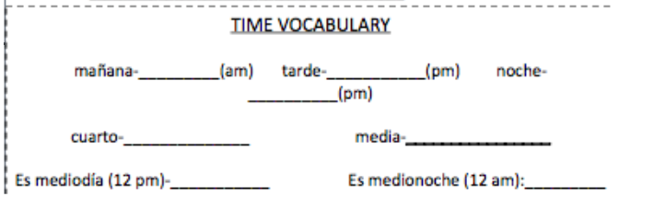
ACUÉRDENSE!!!
morning
afternoon
night
Quarter
(15 mins.)
Half
(30 mins.)
It’s noon.
It’s midnight.

Slide 4
LA HORA: AFTER THE HALF HOUR
Es la/ Son las + ______________ MENOS _____________
(hour + 1) (min. to the next hour)
Son las doce menos veinticinco de la mañana.
Son las nueve menos cuarto de la noche.

Slide 5
Many Spanish speakers subtract the number of minutes from the hour that will be completed, starting after the half hour (31-:59)
2:35 Son las tres menos veinticinco
4:40 Son las cinco menos veinte
12:50 Es la una menos diez
:45 Fifteen minutes before the hour is expressed: menos cuarto
12:45 Es la una menos cuarto
1:45 Son las dos menos cuarto
9:45 Son las diez menos cuarto

Slide 6
EL RELOJ

Slide 7
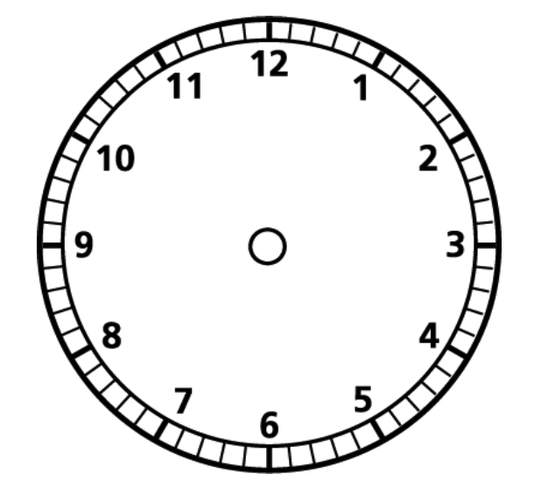
EL RELOJ: LA HORA
En punto
Menos cinco
Y cinco
Menos diez
Y diez
Y
Menos quince/
Menos cuarto
menos
Y quince/
Y cuarto
Menos veinte
Y veinte
Menos veinticinco
Y veinticinco
Y treinta /
Y media
Notes:
Divide clock in half and have kids write “menos” on the left side. Explain this is a reference guide for them to use.

Slide 8
EJEMPLOS
.

Slide 9
1. Tell me IN SPANISH the digital time given to you.
7:55pm
Son las ocho menos cinco de la noche.
Who can explain, in complete steps, how we got there?

Slide 10
2. Tell me IN SPANISH the digital time given to you.
3:45am
Son las cuatro menos cuarto de la mañana.
Who can explain, in complete steps, how we got there?

Slide 11
3. Tell me IN SPANISH the digital time given to you.
11:50pm
Son las doce menos diez de la noche.
Who can explain, in complete steps, how we got there?

Slide 12
LAS PIZARRITAS: TEAM HUDDLES

Slide 13
TEAM HUDDLE RULES:
You will work in groups of 4.
Give your team a name (write it on both index cards; one for me and one for you).
Number each person in your team (1-4)
I will put a digital time on the board.
YOU and everyone on your team will write down the Spanish time.
Everyone must write the exact same thing on their whiteboard.
I will draw a team name and # 1-4, and that person will be responsible for answering the question.
I will then ask to see EVERYONE’S whiteboard. Do not erase until I ask you to do so.
Notes:
Notes:
-Have teams write their team names on two index cards (write the same team name twice); you collect one and they keep the other
-Double check that kids have numbered themselves by asking them to raise their hands, etc.
-if there are fewer than 4 people in a group, have kids take more than one number so that ALL numbers are used
Have a solution station up in the room with the correct answers; only allow one student from each team to go to prevent traffic jams (this ensures that students are practicing correctly and that they’re confident—ie don’t give up and shut down).
Call time (depending on the question; varies)
-Draw a team name. Draw a number. This is the person who will answer! For example, if Bob is the number 2 at team “Bobcats,” then Bob will answer if you draw bobcats and 2. You can play with it too—draw a number first, have all number 3’s stand up, and then have everyone except the number 3 on the “dodo birds” team sit down (builds anticipation and holds all kids accountable)
-Celebrate answer!
Move on to next question!

Slide 14
EJEMPLO:
1:55pm
Son las dos menos cinco de la tarde.

Slide 15
1:
4:50am
Son las cinco menos diez de la mañana.

Slide 16
2:
7:45pm
Son las ocho menos cuarto de la noche.

Slide 17
3:
11:35am
Son las doce menos veinticinco de la mañana.

Slide 18
4:
10:57pm
Son las once menos tres de la noche.

Slide 19
5:
2:45am
Son las tres menos cuarto de la mañana.

Slide 20
6:
3:55pm
Son las cuatro menos cinco de la tarde.

Slide 21
TAREA
Study telling time for your test!!!

