Slide 1
Vámonos: TIENEN 5 MINUTOS
Objective:
I can greet someone or say goodbye, I can sing the alphabet.
Vocab/Ideas:
El alfabeto
CH
LL
Ñ
RR
Vámonos:
Next Slides

Slide 2
VÁMONOS (1-2) 7th
Escribe la fecha y el objetivo.
1.On a scale from 0-10, how much material do you think you remember from 6th grade Spanish? Why?
2. Do you think it’s necessary to remember last year’s Spanish “stuff” in order to be successful this year? Why or why not?
Vocab/Ideas:
El alfabeto
CH
LL
Ñ
RR

Slide 3
VÁMONOS (1-2) 8th
Escribe la fecha y el objetivo.
On a scale from 0-10, how much material do you think you remember from 7th grade Spanish? Why?
Do you think it’s necessary to remember last year’s Spanish “stuff” in order to be successful this year? Why or why not?

Slide 4
EL OBJETIVO
I can spell my name and others words.
I can sing the alphabet in Spanish.

Slide 5
Tarea
PRACTICE: The alphabet in Spanish and Spell your name in Spanish.
Practice the alphabet song ( Ms. Lugo Web page)
At least 15 minutes

Slide 6
http://www.youtube.com/watch?v=ngRq82c8Baw
MOMENTO CULTURAL
Spanish Love Song:
Look what you are going to be able to do and understand at the end of the class
Notes:
http://www.youtube.com/watch?v=ngRq82c8Baw

Slide 7
Self-Evaluation

Slide 8
INM: El ALFABETO

Slide 9
El alfabeto
Spanish is a PHONETIC language.
This means that it is spelled the way it sounds—unlike English.
Ex. Telephone vs. teléfono
It has 4 EXTRA letters because it’s EXTRA awesome!
Ch
Ll
Ñ
Rr

Slide 10
Las Vocales
Vowels in Spanish are PURE.
This means that they always sound the same, regardless of what consonants they’re next to.
In English: Same vs. Sam
En español: manzana
Lucky for you, Spanish has the same vowels as English!
A
E
I
O
U
Let’s look! Open your content book to página 45.

Slide 11
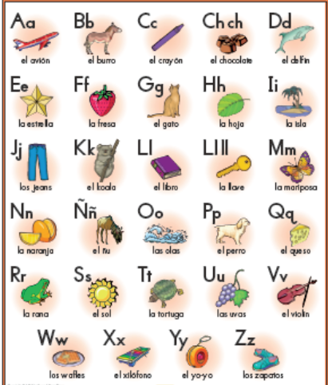
Each letter has a word in Spanish that exemplifies its sound…let’s practice saying the words!

Slide 13
GP: LA CANCIÓN DEL ALFABETO!!!
You are going to sing.
And you are going to love it.
(Es una competencia!)
Primera vez- Listen
Segunda vez
Tercera vez- Sing
Notes:
http://www.youtube.com/watch?v=JUcu9PUh9_A
1st time just have students listen
2nd time have students listen and look at the page in their books as they follow along
3rd time have students try to sing along

Slide 14
IP: HUMAN SPELLING
You will all receive AT LEAST one letter from me. If you get more than one—qué suerte!
I am going to spell out IN SPANISH a word. If you think that your letter belongs in the word, come to the front of the room. Your other classmates and you will need to stand in the correct order in which the word is spelled.
If you are not in the word, you should be writing it in your cuaderno! (There are 8.)

Slide 15
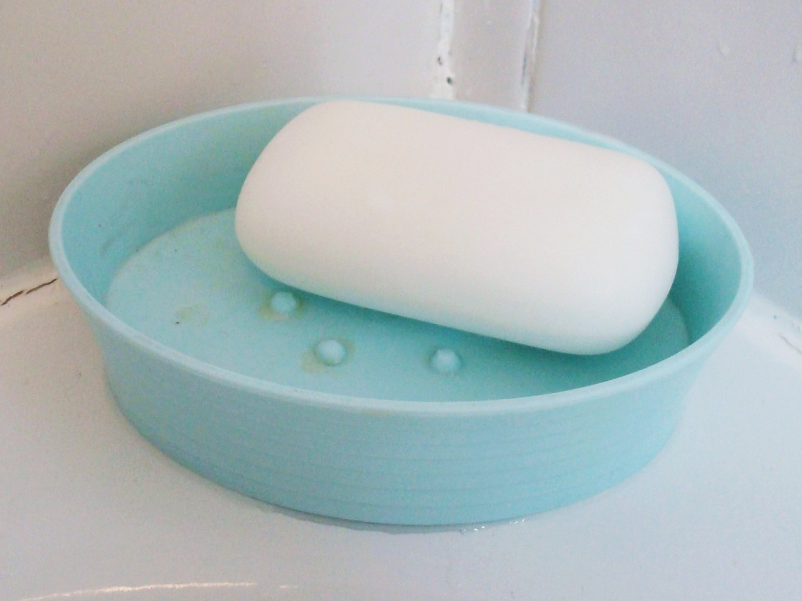
1. JABÓN

Slide 16
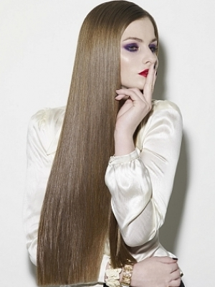
2. LARGO

Slide 17
3. NARIZ

Slide 18
4. BOTAS

Slide 19
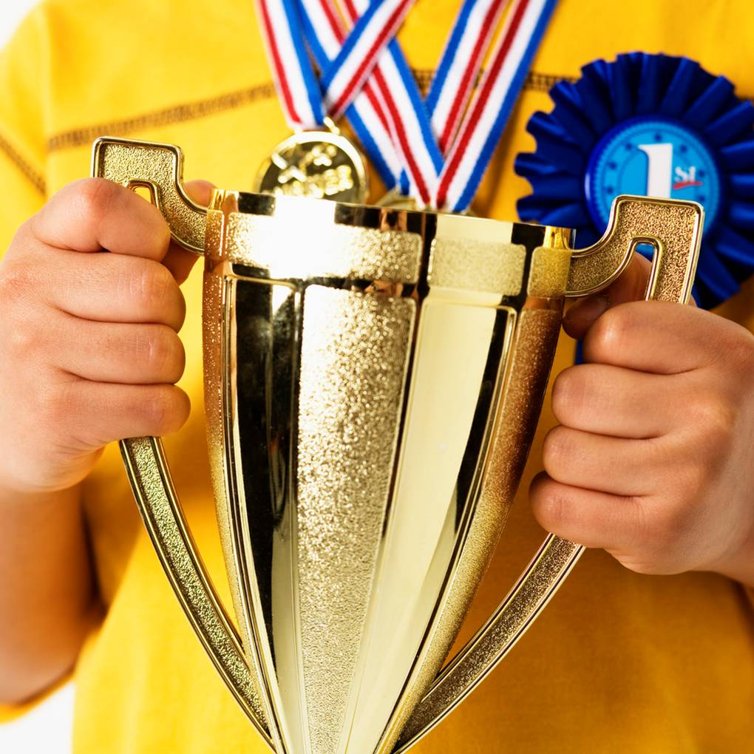
5. CAMPEÓN

Slide 20
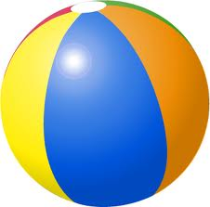
6. PELOTA

Slide 21
5. CAMPEÓNES

Slide 22
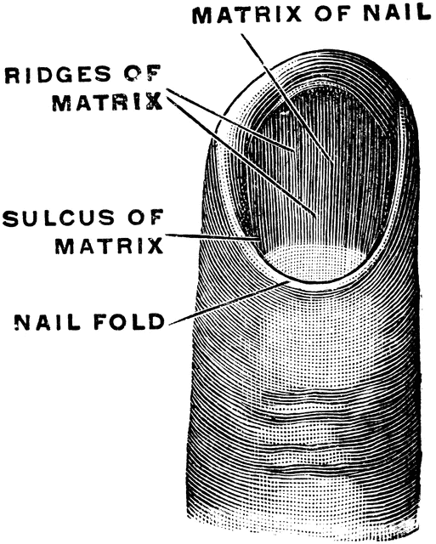
7. UÑA

Slide 23
8. CHARRO

Slide 24
IP: WHITEBOARD COMPETITION
We will be having a COMPETITION to see which side of the room can spell a word correctly in Spanish the fastest.
There are 10 questions, and I will SPELL the word in Spanish. You must WRITE it on your whiteboard ASAP. I will nod if yours is correct, or shake my head if it is not. The first side of the room with 100% correct wins a point!

Slide 25
LEÓN
1.

Slide 26
PATO
2.

Slide 27
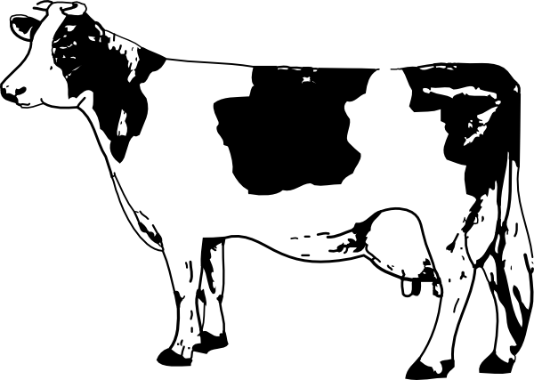
VACA
3.

Slide 28
ROJO
4.

Slide 29
UNO
5.
1

Slide 30
ESPAÑA
6.

Slide 31
MÉXICO
7.

Slide 32
CAFÉ
8.
L

Slide 33
GRIS
9.
L

Slide 34
UVAS
10.

Slide 35
GP: CÓMO SE ESCRIBE?
With your partner, you will be working on writing the words based on the pronunciation. Remember, Spanish is phonetic! USE YOUR GUIDE!!!
You have 5 minutes.

Slide 36
¿Cómo se escribe?
Direcciones: Your friend Mara is teaching you how to write words in Spanish. Based on her pronunciation, write the word in Spanish. Then, guess what the words mean in English.
1. She says: “Hey, ee, em-may, en-nay, ah, es-say, ee, oh.”
You write: __________________________________
You think it means: _________________________
2. She says: “Oh, eff-ay, ee, say, ee, en-nay, ah.”
You write: __________________________________
You think it means: _________________________
3. She says: “Set-a, eh, bay, er-ray, ah.”
You write: __________________________________
You think it means: _________________________
4. She says: “Ah-chay, ah, em-may, bay, ooo, er-ray, hey, ooo, eh, es-say, ah.”
You write: __________________________________
You think it means: _________________________
gimnasio
gymnasium
oficina
office
zebra
zebra
hamburguesa
hamburger

Slide 37
IP: LISTENING SPELLING-BEE!!!
.
Escucha while I say a word twice. The first time, write down the letters you hear (with the help of your phonetic guide). The second time, check your work!

Slide 38
Nombres Comunes Common Names in Spanish
Chicas( Girls)
Ana
Bárbara
Beatriz
Cecilia
Cristina
Dolores
Elena
Isabel
María
Patricia
Chicos (boys)
Alfredo
Antonio
Fernando
Alejandro
Miguel
Pablo
Roberto
Sergio
Victor
Julio

Slide 40
IP: Alfabeto
Foldable

Slide 41
Reflection

