Slide 1
Vámonos
Sit down quickly and quietly and complete the Warm-Up

Slide 2
Computer Log-in

Slide 3
INM: Comic Strip

Slide 4
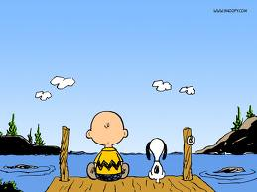
COMIC STRIP
www.toondoo.com
We are using Fire Fox
Create an account
First name last name 2A
Example: dianalugo2A

Slide 5
Comic Strip
Today you will create an electronic Comic strip
Your Comic Strip Must Include:
2 greetings
2 farewells
What’s your name? (Q&A)
How are you? (Q&A)
Where are you from? (Q&A)
3 “extras”—ANY previous vocabulary

