Slide 1
VÁMONOS
Free reading!!!!!
Write a paragraph about any topic we have studied so far. Do your best! I am collecting your work for a informal grade.
Gracias,
Señora Santiago

Slide 2
EL OBJETIVO:
I can understand descriptions of people when I hear them or read them
I can ask someone to describe himself/herself

Slide 3
VOCABULARIO
Describing Myself with “I am” and “I am not….” | Yo soy….No soy
Physical traits | Físicamente
A little…..a lot… | Un poco……muy
Tall | Alto (a)
Short | Bajo (a)
Medium | Mediano size (a)
Good-looking | Guapo (a)
Pretty | Bonito (a)
Ugly | Feo (a)
Redhead | Pelirrojo (a)
Blond | Rubio (a)
Brunette | Moreno (a)
Fat | Gordo (a)
Skinny | Delgado (a)/ flaco (a)
Big | Grande

Slide 4
Personality Traits
Nice | Simpático (a)
Not nice | Antipático (a)
Polite | Amable
Funny | Cómico (a)
Cool | Chévere
Serious | Serio (a)
Athletic | Atlético (a)
Shy | Tímido (a)
Outgoing | Extrovertido (a)
Lazy | Perezoso (a)
Hard-working | Trabajador (a)
Intelligent | Inteligente
Interesting | Interesante

Slide 5
Describing Myself with “I have” and “I don’t have” | Yo tengo y no tengo
Hair | El pelo
Long hair | El pelo largo
Short hair | El pelo corto
Medium size hair | El pelo mediano
Blond hair | El pelo rubio
Wavy hair | El pelo ondulado
Straight hair | El pelo liso
Curly hair | El pelo rizado
Eyes | Los ojos
Big eyes | Los ojos grandes
Small eyes | Los ojos pequeños
Medium size eyes | Los ojos medianos
Green, blue, black, brown (ANY COLOR, but make the color plural) | Los ojos verdes, azules, negros, de color café

Slide 6
Nose | La nariz
Big nose | La nariz grande
Small nose | La nariz pequeña
Medium size nose | La nariz mediana
Mouth | La boca
Big mouth | La boca grande
Small mouth | La boca pequeña
Medium size mouth | La boca mediana
Describing others using have/has (hair, eyes, nose, mouth and ears)
You have…. Do you have? | Tú tienes ¿Tienes tu?
PERSON HAS | PERSON tiene….
Sara has long hair | Sara tiene el pelo largo
He has short hair | El tiene el pelo corto
She has medium size hair | Ella tiene el pelo mediano
Does PERSON have….? | ¿TIENE PERSON….?
¿Does Sara has blue eyes? | ¿Tiene Sara los ojos azules?

Slide 7
SUBJECT
ending
A
O

Slide 8
S
S

Slide 9
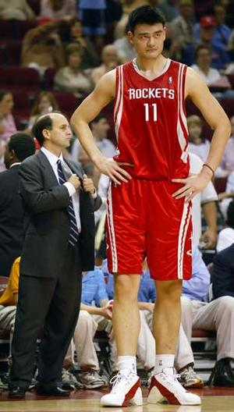
Alto(a)
Tall

Slide 10
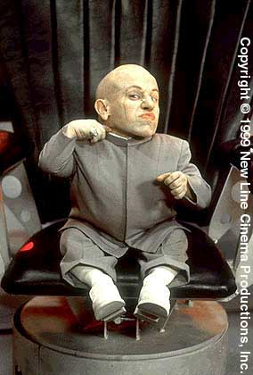
Bajo(a)
Short

Slide 11
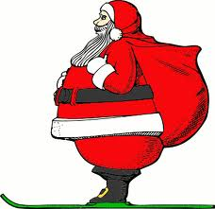
Gordo(a)
Fat

Slide 12
Delgado(a)
Skinny

Slide 13
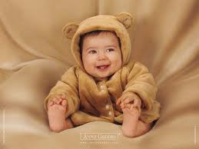
Joven
Young

Slide 14
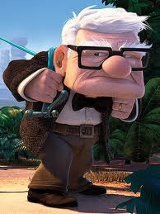
Viejo(a)
Old

Slide 15
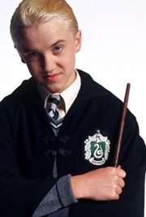
Rubio(a)
Blonde

Slide 16
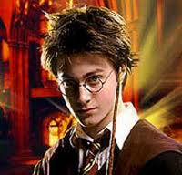
Moreno(a)
Dark-haired

Slide 17
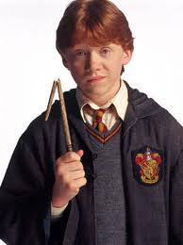
Pelirrojo(a)
Red-headed

Slide 18
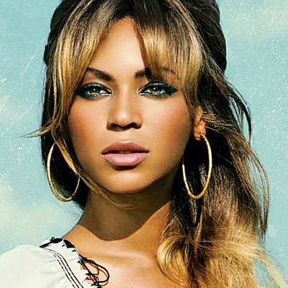
Bonito(a)
Pretty

Slide 19
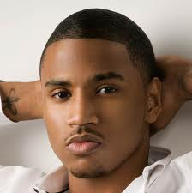
Guapo(a)
Good-looking

Slide 20
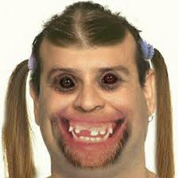
Feo(a)
Ugly

Slide 21
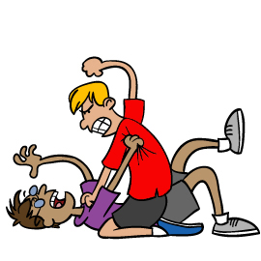
Antipático(a)
Mean/Unfriendly

Slide 22
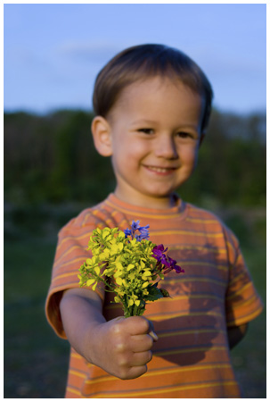
Simpático(a)
Nice/ Friendly

Slide 23
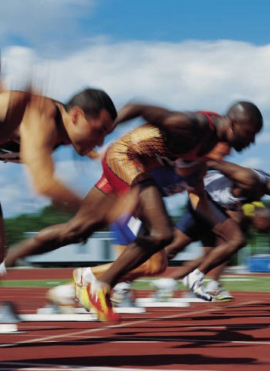
Activo(a)
Active

Slide 24
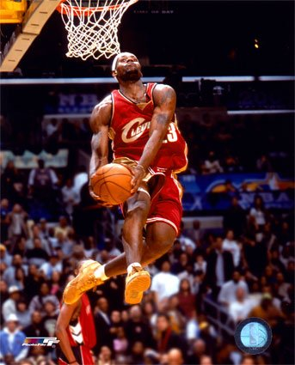
Atlético(a)
Athletic

Slide 25
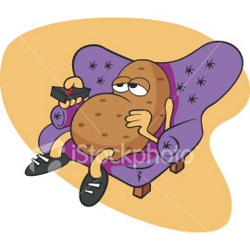
Perezoso(a)
Lazy

Slide 26
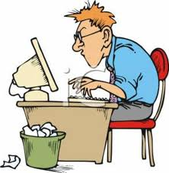
TRABAJADOR(a)
Hard-working

Slide 27
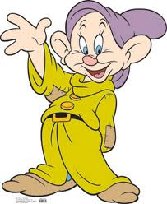
Tonto(a)
Silly

Slide 28
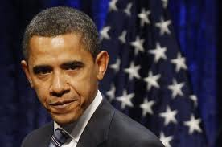
Serio(a)
Serious

Slide 29
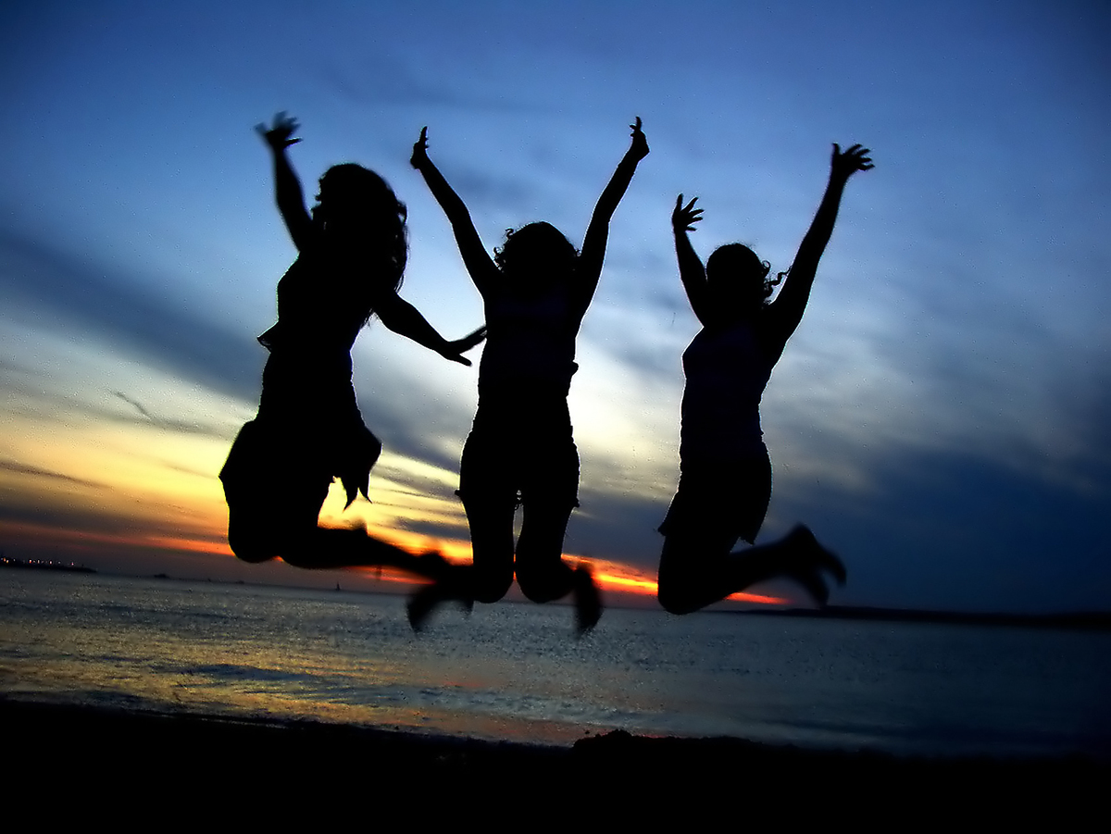
Divertido(a)
FUN!

Slide 30
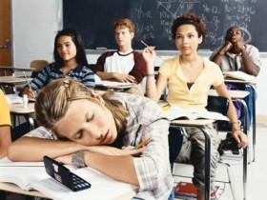
Aburrido(a)
Boring

Slide 31
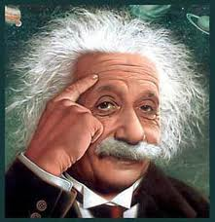
Intelectual
Intellectual

Slide 32
Inteligente
Intelligent

Slide 33
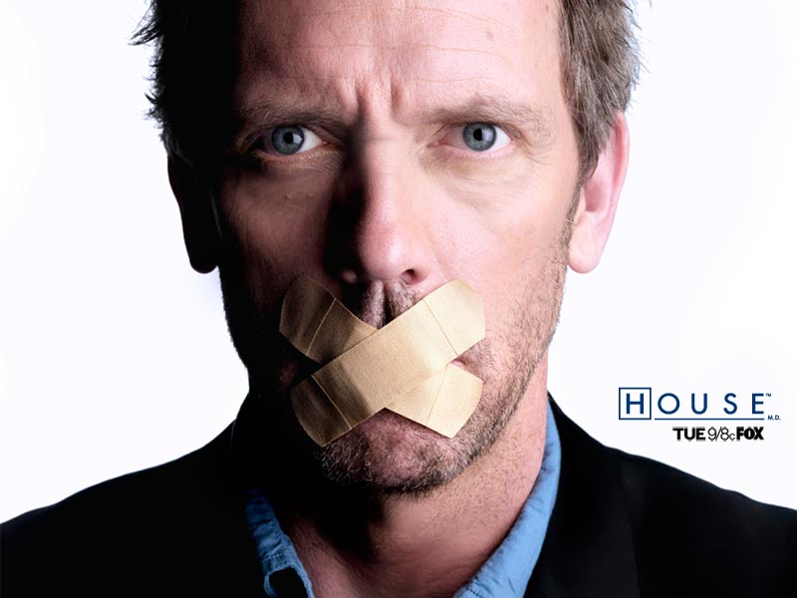
Gracioso(a)
Witty

Slide 34
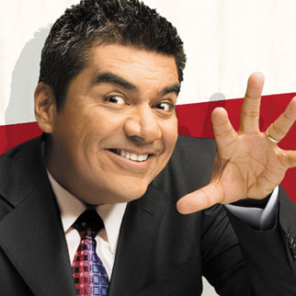
Cómico(a)
Funny

Slide 35
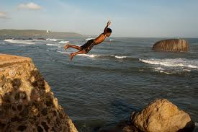
Extrovertido(a)
Outgoing

Slide 36
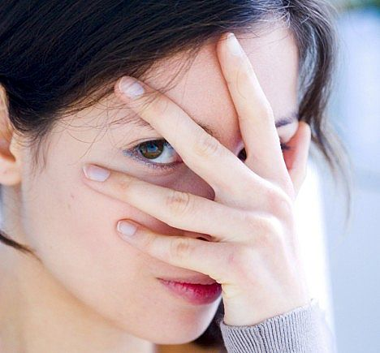
Tímido(a)
Shy

Slide 37
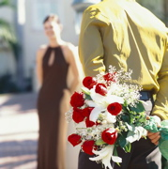
Romántico
Romantic

Slide 38
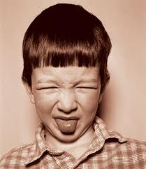
Pésimo(A)
Awful

Slide 39
Formidable
Wonderful

Slide 40
FENOMENAL
AWESOME!

Slide 41
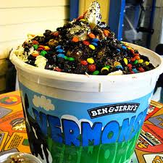
Delicioso(a)
Delicious

Slide 42
Horrible
Horrible

Slide 43
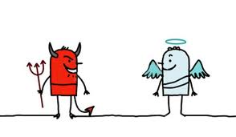
MALO(A)
BUENO(A)
BAD
GOOD

Slide 44
Interesante
Interesting

Slide 45
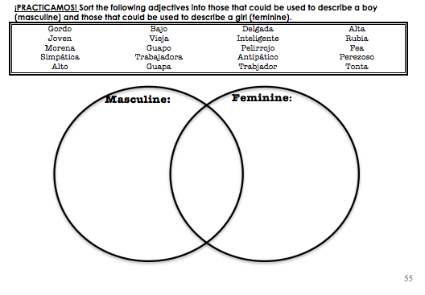
Fea
Trabajador
Morena
Gordo
Joven
Simpática
Alto
Inteligente
Trabajadora
Bajo
Perezoso
Guapa
Guapo
Tonta
Delgada
Pelirrojo
Alta
Antipático
Rubia
Notes:
Have students come and write on the board! Or, if you’re short on time, just verbally talk it out

Slide 46
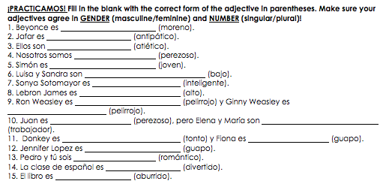
morena
antipático
atléticos
perezosos
jovén
bajas
inteligente
alto
pelirrojo
pelirroja
perezoso
trabajadoras
tonto
guapa
guapa
románticos
divertidos
aburrido

Slide 47
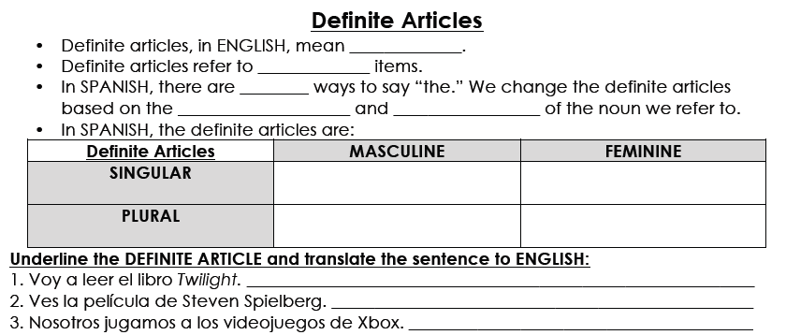
the
known
4
gender
number
EL
LA
LOS
LAS
I’m going to read the book Twilight.
You watch the Spielberg movie.
We play the Xbox games.

Slide 48
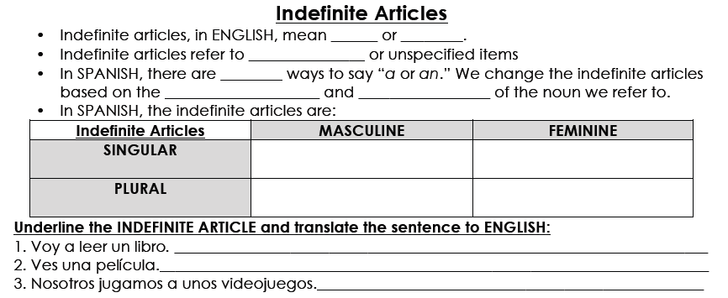
a/an
some
unknown
4
gender
number
UN
UNA
UNOS
UNAS
I’m going to read a book.
You’re watching a movie.
We play some videogames.

Slide 49
THE FORMULA!
SUBJECT
+
SOY/ERES/ES/
+
ADJECTIVE
How do we know which verb to use?
Do we need to make our adjective MATCH our subject? How?

Slide 50
Let’s do it together!
SUBJECT:
VERB:
ADJECTIVE:
Sentence:
La profesora
es
gracioso
Sentence: La profesora es graciosa.
SUBJECT:
VERB:
ADJECTIVE:
Sentence:
SUBJECT:
VERB:
ADJECTIVE:
Sentence:
Notes:
First is the example, then do two as a class (encourage them to be SPICY and CREATIVE)

Slide 51
Work with a partner: Answer the following questions in COMPLETE sentences. Use as many adjectives as possible. Write answers in the worksheet.
1. ¿Cómo eres tú?
2. ¿Cómo es tú compañero (a)/parner?
3. ¿Cómo es la profesora de español?
4. ¿Cómo es tú mamá?
Notes:
Llamar a dos alumnos

Slide 52
Describing other using Have/has….
SPANISH: | ENGLISH
Ella tiene el pelo negro corto largo | She has hair black short long
El tiene los ojos ________ azules verdes castaños avellanos grandes pequeños | He has _______ eyes blue green brown hazel big small
Notes:
Give students 2 minutes or so to copy down, and then discuss

Slide 53
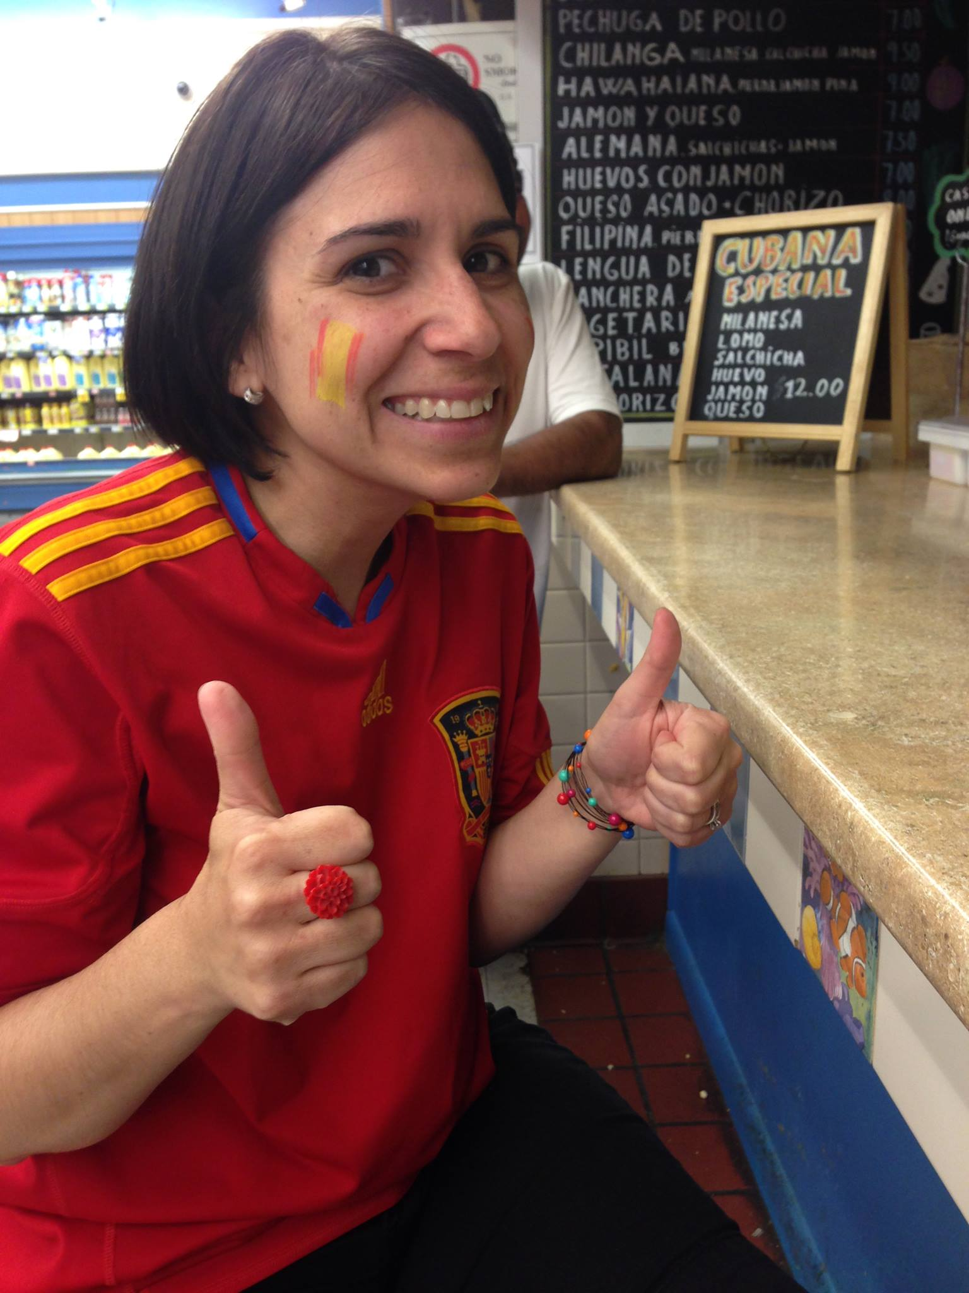
La profesora de español
La profesora de español tiene el pelo negro y corto
La profesora de español tiene los ojos marrones y grandes
La profesora de español tiene las orejas grandes
La profesora de español tiene la boca mediana

Slide 54
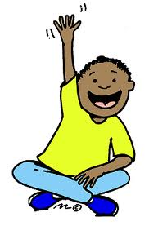
GP I: LO TENGO!!!

Slide 55
Pizarritas!
You will see a picture and an adjective.
On your board write a COMPLETE SENTENCE describing the picture you see.

Slide 56
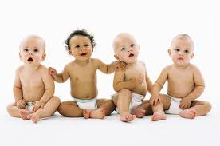
Ellos son
_________
(joven).
jóvenes

Slide 57
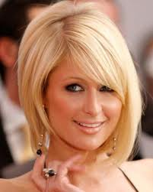
Paris Hilton es
_________
(rubio).
rubia

Slide 58
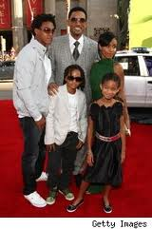
Ellos
son
_________
(moreno).
morenos

Slide 59
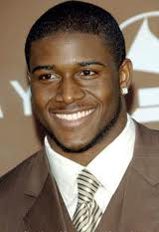
Él
es
_________
(guapo).
guapo

Slide 60
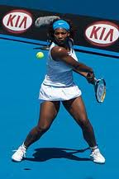
Ella
es
_________
(activo).
activa

Slide 61
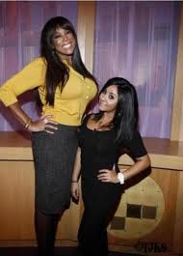
Snooki es _________
(bajo).
baja

Slide 62
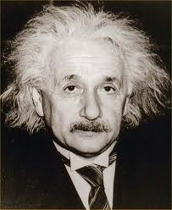
Él
es
____________
(inteligente).
inteligente

Slide 63
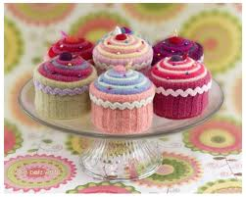
Las magdalenas
son
____________
(delicioso).
deliciosas

Slide 64
Las magdalenas
son
____________
(delicioso).
deliciosas

Slide 65
More ADJECTIVES… MUST AGREE!

Slide 66
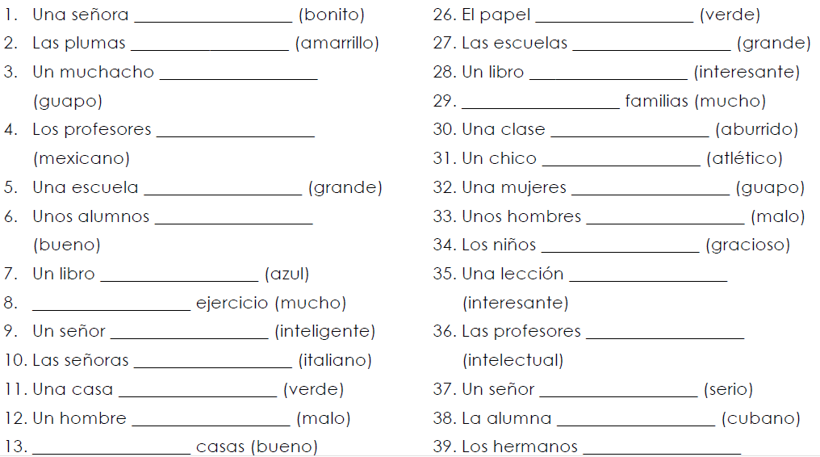
Notes:
Have students write on the board, or quickly go over it as a class

Slide 67
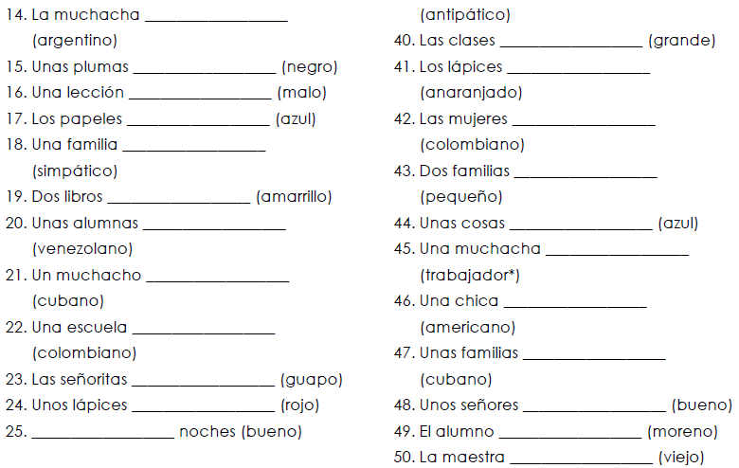
Notes:
Have students write on the board, or quickly go over it as a class

Slide 68
Speaking and writing Practice with Partner:
Work with a partner and create a dialogue including the following information. Write the dialog and practice it orally.
Say who you are and spell your first and last name using the Spanish Alphabet.
Greet a new classmate and ask his/her name
Ask him/her how to spell their name
Ask your classmate how he/she is feeling
Tell your classmate how you are feeling today (use a complete sentence)
Introduce John and Jennifer to your new friend.
Tell your new friend goodbye.
Tell Jennifer you will see her later.
Tell John you will see him tomorrow

Slide 69
Writting Prompt: You and your best friend are going to a school in Ecuador for a short home stay next summer. In order to introduce yourselves, you and your best friend can write a short email to the school giving the following information.
• Greetings
• Both of your names and where you and your best friend are from
• Two physical description of you and your best friend
• Two personality descriptions of you and your best friend
• Another information about you and your best friend.
• Saying Goodbye

