Slide 1
VÁMONOS
Write a short paragraph about your “ideal” house.

Slide 2
OBJETIVO:
I can say and write my name and spell it for someone
I can understand and use commonly used word and expressions, such as please and thank you
I can greet people, ask how they are, and give a farewell in a polity way
I can respond to a greeting and say how I am
I can introduce myself and other suing basic, appropriate greetings and even gestures when needed
I can ask someone what his/her name is and how to spell it
I can talk about where people are from

Slide 3
Greetings & Farewells

Slide 4
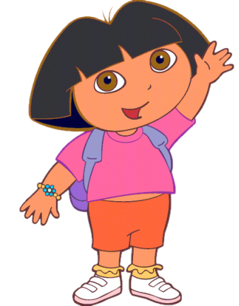
Hola
Hello

Slide 5
Buenos días
Good morning

Slide 6
Buenas tardes
Good afternoon

Slide 7
Buenas noches*
Good evening/night
This can be a greeting OR a goodbye

Slide 8
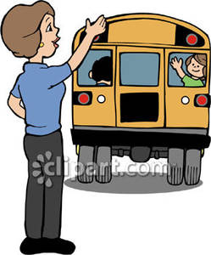
Adiós
Goodbye

Slide 9
Hasta luego / Nos vemos
See you later

Slide 10
Hasta mañana
See you tomorrow

Slide 11
Tengo que irme
g2g
I have to go!

Slide 12
Buenas noches
Buenos días
Hola
Buenas noches
Adiós
Hasta luego
Buenas tardes
Notes:
Use worksheet

Slide 13
Asking about and saying who people are?
Where are you from?

Slide 14
¿Cómo te llamas?
What is your name?

Slide 15
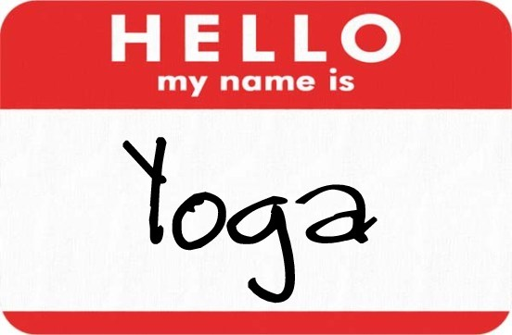
Me llamo…
My name is…

Slide 16
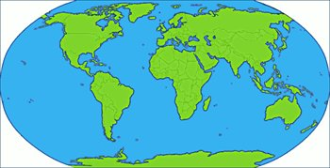
¿De dónde eres (tú)?
Where are you from?

Slide 17
Yo soy de…
I am from…

Slide 18
Asking How people are ?

Slide 19
¿Cómo estás (tú)? (informal)
How are you?

Slide 20
¿Cómo está usted? (formal)
How are you?

Slide 21
Yo estoy (muy) bien.
I am (very) good.

Slide 22
Yo estoy así así /
más o menos.
I am okay.

Slide 23
Yo estoy (muy) mal.
I am (very) bad.

Slide 24
Qué diría la persona?
What would the person say if asked how they were feeling/doing?

Slide 25
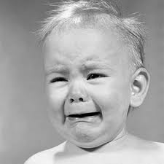
Cómo estás?
Estoy mal

Slide 26
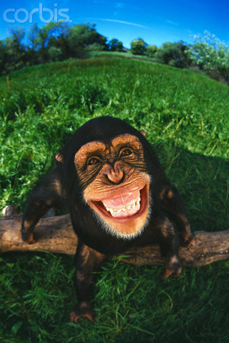
Cómo estás?
Estoy bien

Slide 27
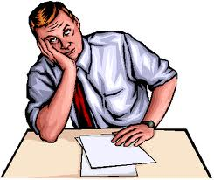
Cómo estás?
Estoy así así

Slide 28
Responding to an introduction

Slide 29
Mucho gusto
Nice to meet you

Slide 30
Igualmente
You too

Slide 31
Qué tal?
How’s it going?

Slide 32
Abecedario…Recuerdas?
You need to know alphabet to spell your name

Slide 33
Notes:
Practice spelling their name in pizzarra

Slide 34
Spell the following words:
1. Casa
2. Ferrocarril
3. Diciembre
4. Números
5. Gusta
6. Miércoles
7. Lorenzo
8. Cumpleaños
9. Alfabeto
10. Maracaibo
11. Spell your name
Notes:
Orally

Slide 35
Grammar (Unit 1): Subject Pronouns
In English, the subject pronoun you is used with anyone, no matter their age or relationship to you. In Spanish, the pronoun you (tú or usted) is based on your relationship to the person. Tú is informal and usted is formal, which is use for people older than you.
Subject pronouns
SINGULAR:
Yo ---------------- I
Tú ---------------- You (informal)
Él ----------------- He
She -------------- She
Usted ----------- You (formal)

Slide 36
Verb to Be (Ser)
You use this verb to respond Where are you/she/he is from?
SINGULAR:
Yo ---------------- Soy ---------- I am
Tú ---------------- eres ---------- You are
Él ----------------- es -------------He is
She -------------- es ------------- She is
Usted ----------- es ------------- You are
María ---------- es -------------- María es
Juan ------------ es -------------- Juan es
¿De dónde eres?/ Where are you from?
Yo soy de Venezuela *
* Always add preposition “de” after a country or city.
¿Dé dónde es María?/Where is Maria from?
Ella es de Chile / Ella es de Charlotte
Notes:
Ask students where are they from?

Slide 37
1. ¿De dónde es Selena Gómez?
Selena es de los Estados Unidos

Slide 38
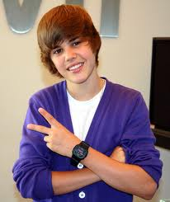
2. ¿QUIÉN ES ÉL?
Él es
Justin
Bieber.

Slide 39
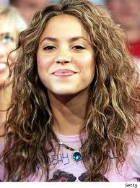
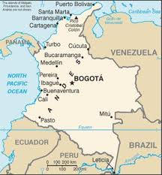
6. ¿DE DÓNDE ES SHAKIRA?
Shakira
es de Colombia.

Slide 40
Tell who each person is and where each person in from
EXAMPLE:
Yo/Carme/Chile Yo soy Carme. Yo soy de Chile
Tú/Roque/El Salvador
2. El/el maestro de español/España
3. Ella/Bárbara/Perú
4. Yo/Alexandra/Venezuela
Notes:
Oral

Slide 41
Complete each sentence with the correct form of the verb “Ser” to tell where people are from
1. Linda Estados Unidos
2. Miguel Argentina
3. La maestra de español Venezuela
4. El Uruguay
5. Yo Perú
6. Usted Ecuador
7. Yo Cuba
8. Tú Chile

Slide 42
Speaking and writing Practice with Partner:
Speaking Prompt: Work with a partner and create a dialogo including the following information. Write the dialog and practice it orally.
1. Say who you are and spell your first and last name using the Spanish Alphabet
2. Greet a Classmate and ask his/her name
3. Ask him/her how to spell their name
4. Ask your classmate how he/she is feeling
Tell your classmate how you are feeling today (use a complete sentence)
Indroduce Juan and Jennifer to your new friend
Tell your new friend goodbye
Tell Jennifer you will see her later
Tell John you will see him tomorrow

Slide 43
Individual Practice:
Writing Prompt: Create a dialogue between two people that just met each other. You MUST include the following information:
• Two greetings
• Two farewells
• What’s your name? (Q&A)
• How do you spell your name?
• How are you? (Q&A)
• Where are you from? (Q&A)
• Saying Goodbye

Slide 44
EXIT TICKET:
Choose the correct response to each question or statement
1. ¿ Quién es? 4. ¿Cómo te llamas?
Hugo a. Perdón
Encantado b. Me llamo Isabel
Me llamo Carlos c. Bien
2. Encantada 5. Me llamo Gabriel
Le presento a Sergio a. Igualmente
¿Y tú? b. Encantad
Igualmente c. Mucho gusto
3. Te presento a Joaquín 6. Mucho gusto
a. ¿Cómo se llama? a. Buenas tardes
b. Mucho gusto b. ¿Quién es?
c. Igualmente c. Encantado (a)
Notes:
Respuestas:
1. A 2. C 3. B 4. B 5. B 6. C

Slide 45
Tarea
STUDY FOR 30 MINUTES!!!
Suggestions:
-Make flashcards (on quizlet or on paper) of today’s vocabulary words, you could call this set “greetings vocabulary”
-Make flashcards on ANY of the vocabulary words from the first couple slides that you do not know/ did not remember
-Study your flashcards or review on quizlet

