Slide 1
Vámonos
Objective: I can understand information about my daily routine when I hear it or read it.
Vámonos: Translate the following sentences:
My mom is blonde
My sisters are intelligent.
My grandmother is nice
I have sixteen cousins.
I have a short hair

Slide 2
VÁMONOS
My mom is blonde.
My sisters are intelligent.
My grandmother is nice.
I have sixteen cousins.
I have a short hair.
Mi mama es rubia.
Mis hermanas son inteligentes.
Mi abuela es simpatica / amable
Yo tengo dieciséis primos.
Yo tengo el pelo corto.

Slide 3
Mi Rutina Diaria

Slide 4
VOCAB/IDEAS
Our new vocabulary words will be on the top of the slide. If you think you know what the word means, raise your hand. I will call on someone to share the definition.
For each new word, we will need an action. After we have the definition, if you can ACT OUT the word, raise your hand. I will call on someone to share the action with the class. Everyone will do the new action.

Slide 5
Me despierto
I wake up (in the morning)

Slide 6
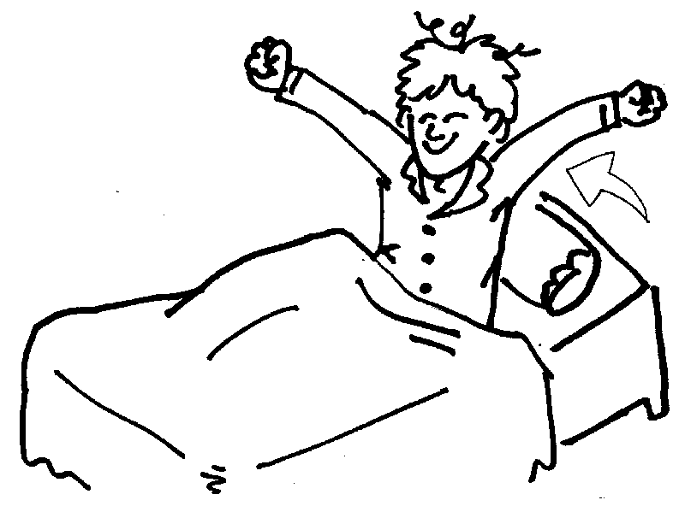
Me levanto
I get up (in the morning)

Slide 7
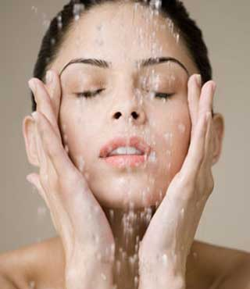
Me lavo la cara
I wash my face

Slide 8
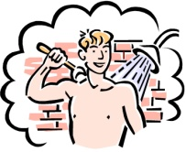
Me baño
I bathe

Slide 9
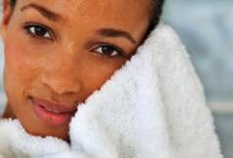
Me seco con una toalla
I dry myself off with a towel

Slide 10
Me cepillo los dientes
I brush my own teeth

Slide 11
Me pongo la ropa
I put on my clothes

Slide 12
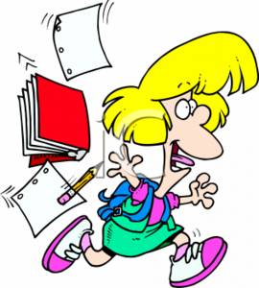
Me voy para la escuela
*I’m going to school

Slide 13
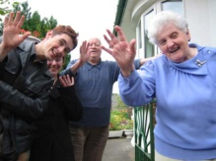
Me despido de mi familia
*I leave from/ say goodbye to my family

Slide 14
Listening Activity

Slide 15
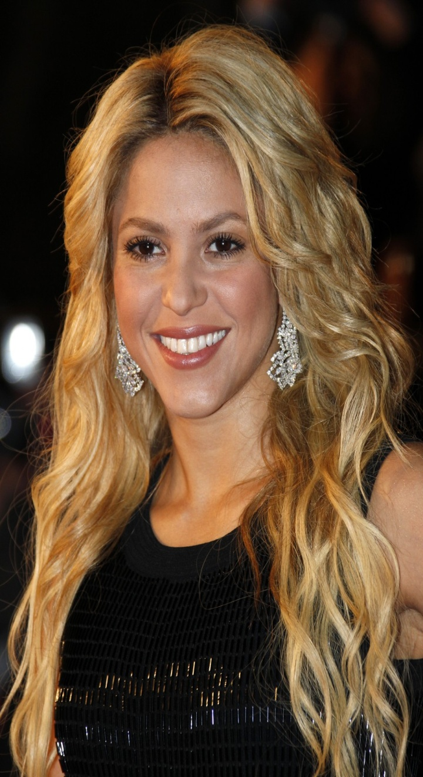
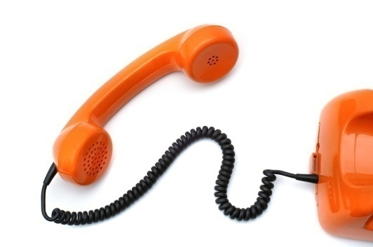
Entrevisor-- Bueno Shakira, ¿cómo es tu rutina diaria?
Shakira—Pues, primero me despierto a las seis de la mañana y después me levanto y me baño. Luego me seco con una toalla y me pongo la ropa. No me gusta mucho la mañana. Siempre estoy muy cansada. Después de ponerme la ropa, me despido la familia y, por fin, me voy para el trabajo.
Notes:
Checklist: Second time to verify answers

Slide 16
La rutina de la mañana de Shakira
_____ Me despierto
_____ Me levanto
_____ Me lavo la cara
_____ Me baño
_____ Me seco con una toalla
_____ Me cepillo los dientes
_____ Me pongo la ropa
_____ Me voy para la escuela
_____ Me despido de mi familia
Notes:
You don’t have to play the listening a third time, but you could reveal the answers and listen one last time to give students the opportunity to listen for any phrases they didn’t orginally hear.

Slide 17
Mi rutina de la Mañana Listening and writing
http://www.youtube.com/watch?v=NSblebrx6ng

Slide 18
Free write
FOCUS on using the new vocab and writing about your morning routine.

Slide 19
Reflection and Homework

