Slide 1
TIENEN 5 MINUTOS
Hoy es _____ de _____ del __________
Objective: ________I can describe someone else’s daily________________ routine__________________________________________________________ ________________________________________________________________________________________________________________________________
Vocab/Ideas: __How to change daily routine to talk about someone else ________________________________________________________________ ________________________________________________________________
________________________________________________________________
Vámonos: Translate the following sentences:
In the morning I eat breakfast.
I eat cereals, fruits and eggs.
Then I drink milk and orange juice.
First I wake up early, later I get up.
Finally I laid down and get some sleep.

Slide 2
Anuncios
Examen Next Class
Mi Rutina Diaria
Wednesday 11-A Day
Thurdsday-12-B day

Slide 3
Repaso

Slide 4
Por la mañana

Slide 5
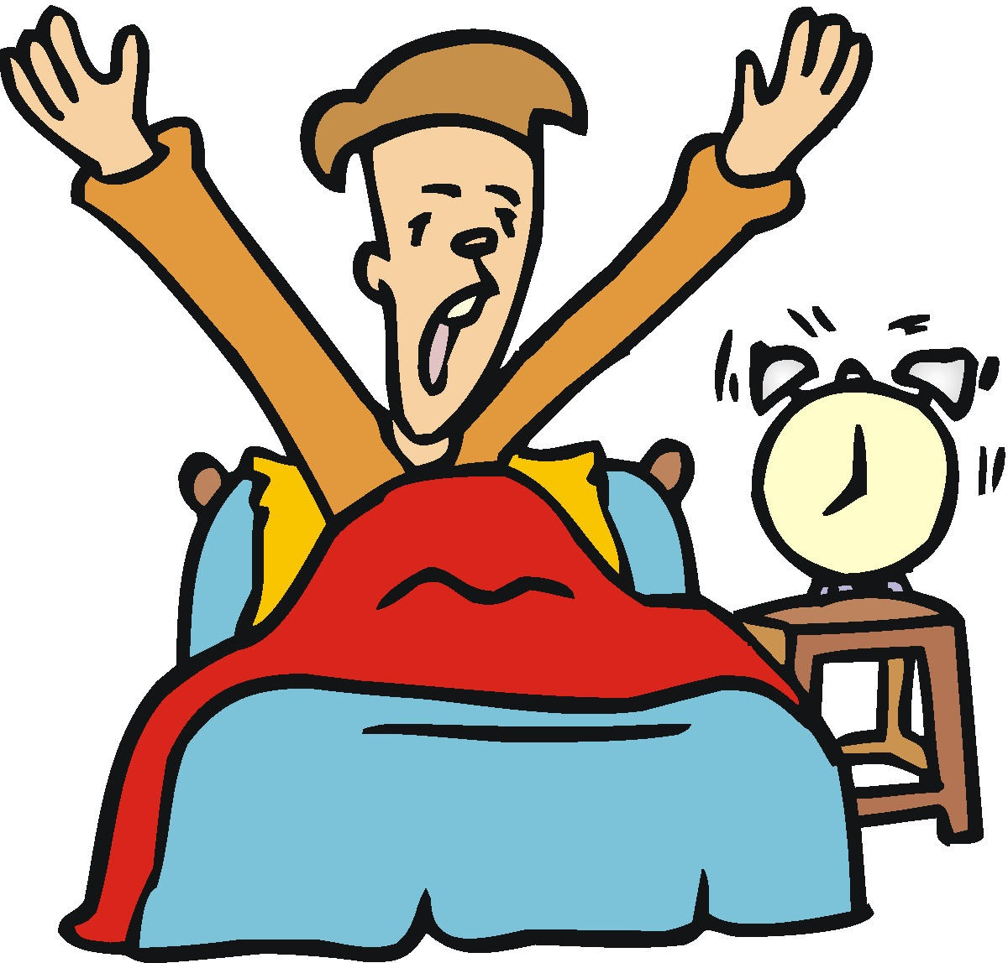

Slide 7
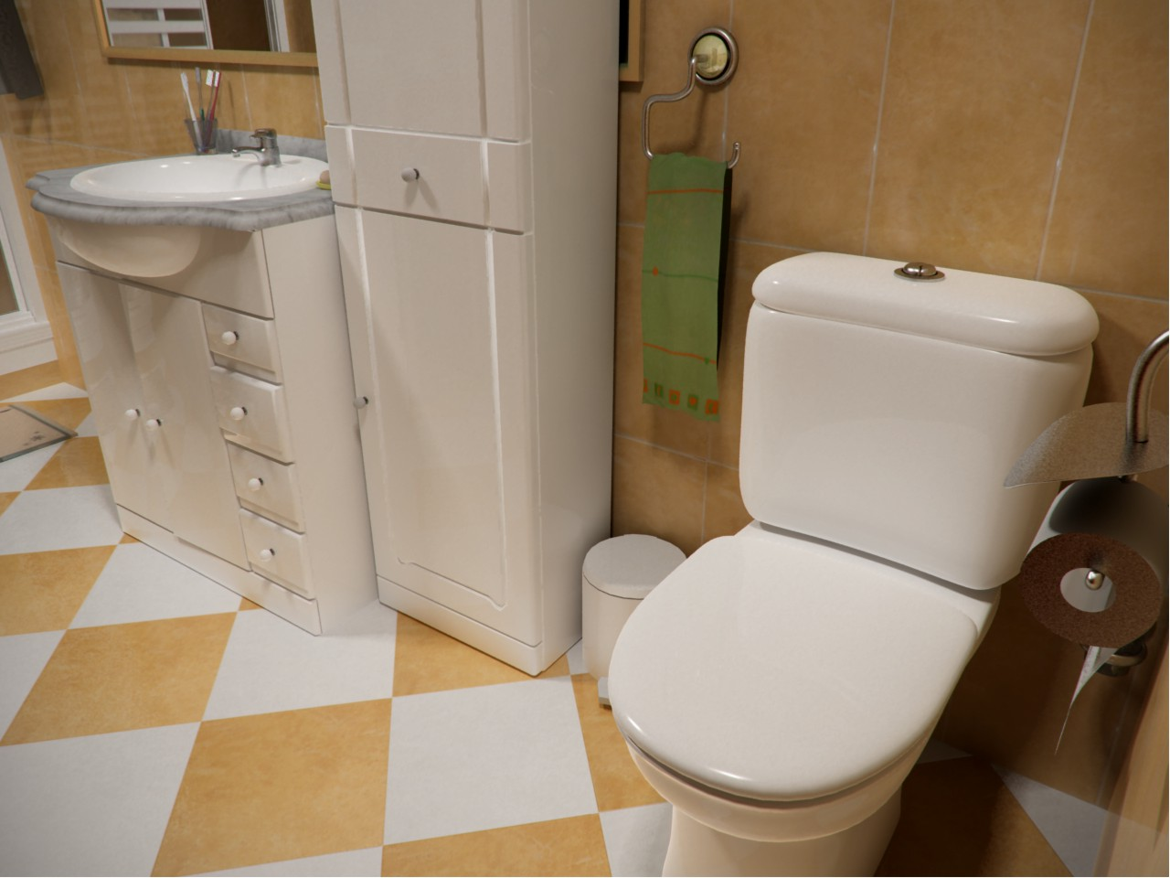
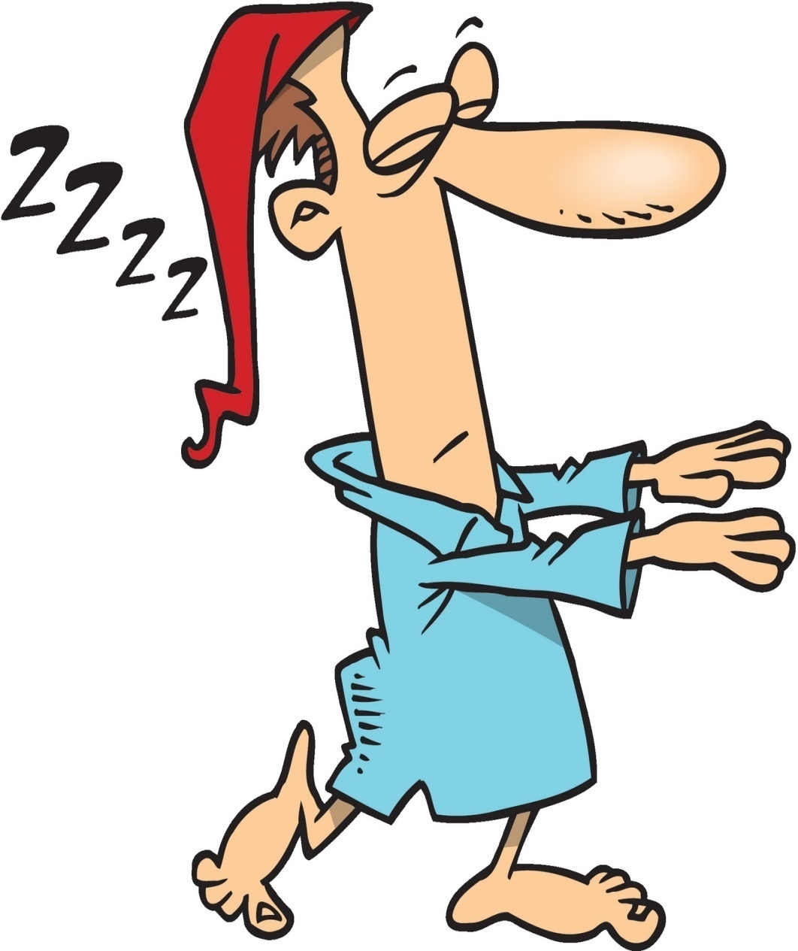

Slide 12
Yo como el desayuno / Desayuno I eat breakfast Yo bebo jugo de naranja I drink orange juice

Slide 15
Por la Tarde

Slide 16
Como el almuerzo/ Almuerzo
I eat Lunch

Slide 17
Salgo de la escuela
I get out of school

Slide 18
Regreso a casa
I come back home

Slide 19
Por la Noche

Slide 20
Como la cena/ Ceno
I eat dinner

Slide 24
INM: changing daily routine to talk about someone else

Slide 25
How to change daily routine to talk about someone else
Take the phrase that you were already using:
Remove the “me” and replace it with the right pronoun:
Take off the “o” and change it to the right ending:
Me baño
For Me -> Me | For Us -> Nos
For You -> Te | ***
For Him/Her -> Se | For Them/You all -> Se
Me baño
For Me -> o | For Us -> amos/emos*
For You -> as/es* | ***
For Him/Her -> a/e* | For Them/You all -> en/an*
Me baño
*When deciding between “a” or “e” choose the one that matches the ending of the verb!

Slide 26
Writing Activity with Daily Routine Part 1
You spent the night with your friend Sam and are describing their daily routine to them, and it’s just like yours! Look at the sentences that you wrote in (1) above and change them to the “tú/te” form to tell about Sam’s routine.

Slide 27
Writing Activity with Daily Routine Part 2
La rutina de Jorge, just alike! Imagine that your friend Jorge has the same daily routine as you. Look at the sentences that you wrote above and change them to the “él/se” form to tell about Jorge’s routine.

Slide 28
REFLECTION AND TAREA
Text next class period

