Slide 1
Vamonos answer the following in complete spanish sentences
¿Cómo te llamas?
¿De dónde eres?
¿Cómo estás?
¿Qué tiempo hace?
¿Cuántos años tienes?

Slide 2
BASIC CONVERSATIONS
Introductions and Greetings

Slide 3
EL OBJETIVO:
I Can greet someone appropriately and tell them how I am doing

Slide 4
Let’s know each other better

Slide 5
Momento Cultural

Slide 6
15 de septiembre – 15 de octubre

Slide 7
INM: WHERE ARE YOU FROM?
¿DE Donde eres?

Slide 8
¿De dónde eres?
To ask someone where they are from, you will use the expression:
¿De dónde eres?
To answer someone when asked where you are from you will use the expression:
Yo soy de…(place)
Useful places:
North Carolina = Carolina del Norte
The United States (USA) = Los Estados Unidos (EEUU)

Slide 9
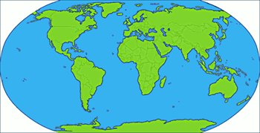
¿De dónde eres (tú)?
Where are you from?

Slide 10
Yo soy de…
I am from…

Slide 11
A practicar

Slide 12
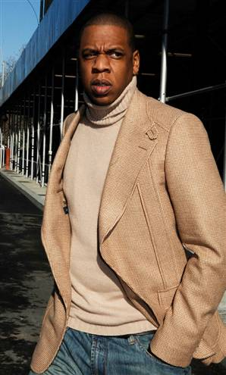
¿De dónde eres, Jay Z?
Yo soy de Nueva York.

Slide 13
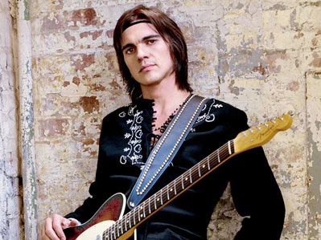
¿De dónde eres, Juanes?
Yo soy de Colombia.

Slide 14
¿De dónde eres, Beyonce?
Yo soy de Tejas.

Slide 15
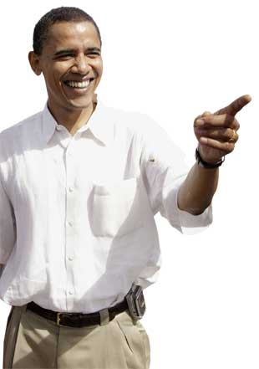
¿De dónde eres, Barack?
Yo soy de Hawái.

Slide 16
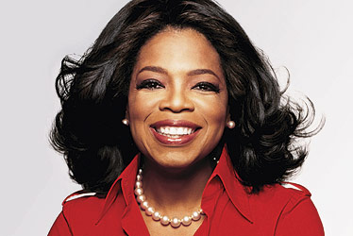
¿De dónde eres, Oprah?
Yo soy de Misisipi.

Slide 17
¿De dónde eres tú?
Notes:
Throw around a stuffed animal!

Slide 18
Yo soy de Puerto Rico.

Slide 19
GP: Tira la pregunta!
We are going to play a QUICK GAME with the new QUESTIONS we’ve learned. I will start by throwing the ball to a person and asking them one of three questions:
- ¿Cómo te llamas?
Me llamo
- ¿De dónde eres tú?
Yo soy de…
- ¿Cómo estás?
Estoy…
You MUST answer in Spanish, then throw the animal to a NEW person and ask them a DIFFERENT question. I will set a TIMER and whoever has the animal when the timer RUNS OUT will get extra TAREA!!!
Notes:
Kind of like hot potato, but just practicing the questions. I say let’s make this a 5 minute activity, tops. If it is not going well, then just cut it and move on. Set the timer for maybe a minute thirty the first round, a minute the second, and 45 the third. 3 rounds should be fine.

Slide 20
Group Practice
You need to pick a celebrity that you are going to pretend to be. I will give you 1 minute to pick your celebrity and write down the name.
You will be going around the room and introducing yourself to other celebrities. Make sure to politely introduce yourself, say that you are please to meet the other person, and ask and answer how the other person is.
Record the responses in your carpeta.

Slide 21
Example
“Hola, me llamo Shakira. ¿Cómo te llamas?”
“Mucho gusto Shakira, me llamo Marc Anthony. ¿Cómo estás?”
“Igualmente. Yo estoy así así. ¿Cómo estás?”
“Yo estoy muy bien. Buenas tardes”
You should talk to at least 5 people. Make sure to record your responses (who you talked to, how they were doing) in your carpeta
NO ENGLISH!
Notes:
http://edtech2.boisestate.edu/baqueron/506/introduction/hello4.html

Slide 22
Individual Practice
Write out the conversations that you had today like they were a script for a movie that someone else could act out. Include all introductions, questions, goodbyes, etc. in your carpeta

Slide 23
Act it Out!
I will now be asking for volunteers:
One person will provide the scene
2 people will actout the scene
BONUS: When other people are acting make sure to write down places they need to work on their grammar or pronunciation!

Slide 24
EXIT SLIP
Translate the following.
¿Cómo estás?
¿De dónde eres?
I’m (doing) bad.
I am from Charlotte.

Slide 25
Participación y Reflección
Fill out your participation reflection in your carpeta to get your stamp!

