Slide 1
Have your paper from last class ready.

Slide 2
Vámonos
TIENEN 5 MINUTOS
Hoy es _____ de _____ del __________
Objective: I can identify and say prepositions
Have your paper from last class ready.
Vámonos: Translate the following sentences:
1. Do you need something to wear?
2. Do you need tickets to go to the movies?
3. I need shoes because I am going to the party
4. I need shorts because its hot
5. Do you need a shirt?

Slide 3
TAREA
15 Minutes of studying prepositions
Next week
Examen
Wednesday – Feb 11 – A day
Thursday-Feb 12-B Day
Mi Rutina Diaria
I need

Slide 4
Speaking Practice

Slide 5
VOCAB/IDEAS
Our new vocabulary words will be on the top of the slide. If you think you know what the word means, raise your hand. I will call on someone to share the definition.
For each new word, we will need an action. After we have the definition, if you can ACT OUT the word, raise your hand. I will call on someone to share the action with the class. Everyone will do the new action.

Slide 6

Sobre
  Over

Slide 7

Detrás de
  Behind

Slide 8
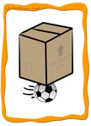
Debajo de
  Underneath

Slide 9
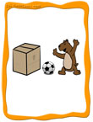
Entre
  In between

Slide 10

Dentro
  In/within

Slide 11

Enfrente de
  In front of

Slide 12
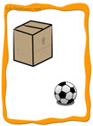
A la izquierda de
  On the left of

Slide 13

A la derecha de
  On the right of

Slide 14

Encima de
  On top of

Slide 15
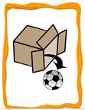
Fuera de
  Out of

Slide 16
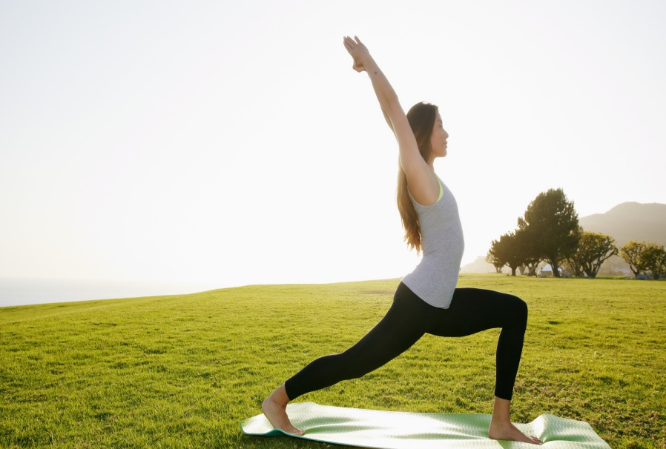
Let’s Stretch ( Vamos a estirarnos)
Sobre
Detras
Debajo
Entre
Dentro
Enfrente a
Izquierda
derecha
Encima
Afuera

Slide 17
Video
http://www.youtube.com/watch?v=JLG974uK_pI
Notes:
https://www.youtube.com/watch?v=6Y3CjaGunEI
https://www.youtube.com/watch?v=Ng3hnlduaOc

Slide 18
GROUP GAME: MATAMOSCAS
I will divide the classroom into 2 teams. Each team will line up in front of the board.
When I say the word in English, the first person will “swat” the word on the board. They will then tell me the word/phrase in Spanish.
For the team to get the point, everyone in line must be doing the action to go along with the word.

Slide 19
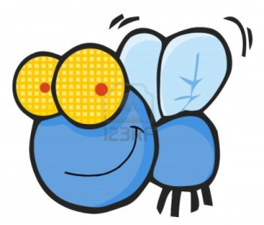





Sobre
Detrás
Debajo
Entre
Dentro
Enfrente
Derecha
Izquierda
Encima
Fuera

Slide 20
Dibujos
Listen for directions on what you are going to draw…

Slide 21
Reflection

