Slide 1
TIENEN 5 MINUTOS
Objective:
  I can use prepositions to help describe where I am located.
Vocab/Ideas:
  You will copy down the definitions as we go through the powerpoint
Vámonos:
  Define the verb estar
  Write out the 5 forms of estar with the pronouns (conjugate the verb estar)

Slide 2
TIENEN 5 MINUTOS
Objective:
  I can use prepositions to help describe where things are located.
Vocab/Ideas:
  Estar
  Estoy
  Estás
  Está
  Estamos
  Estáis
  Están
Vámonos:
  1. I need a red shirt.
  2. Do you need something to eat and money?
  3. The house is to the left of the bank.
  4. The pen is on top of the desk.
Take out your paper from last class

Slide 3
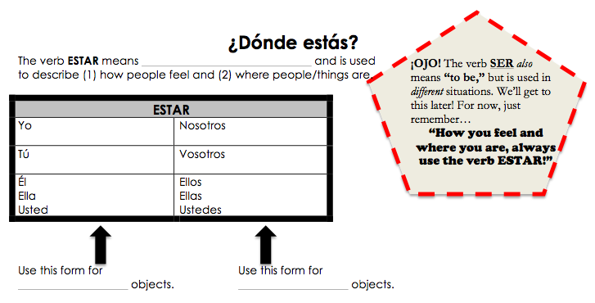
to be
estoy
estamos
estás
estáis
está
están
singular
plural

Slide 4
Quiz - Thursday B-Day
Friday A -Day
Prepositions
Places
I need

Slide 5
Prepositions Review
Saquen tus apuntes.

Slide 6
Vocabulario
If you think you know the Spanish word that goes along with the picture (from your vocabulary list) we are going to do JUMP, SHOUT, SIT

Slide 7
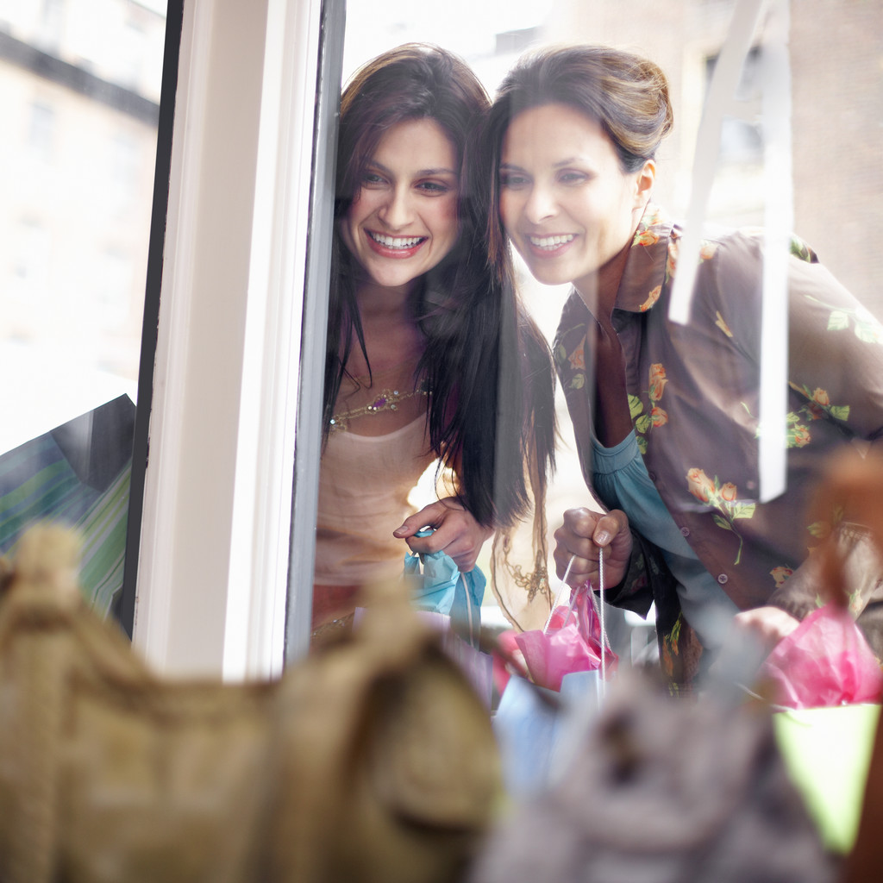
La tienda

Slide 8
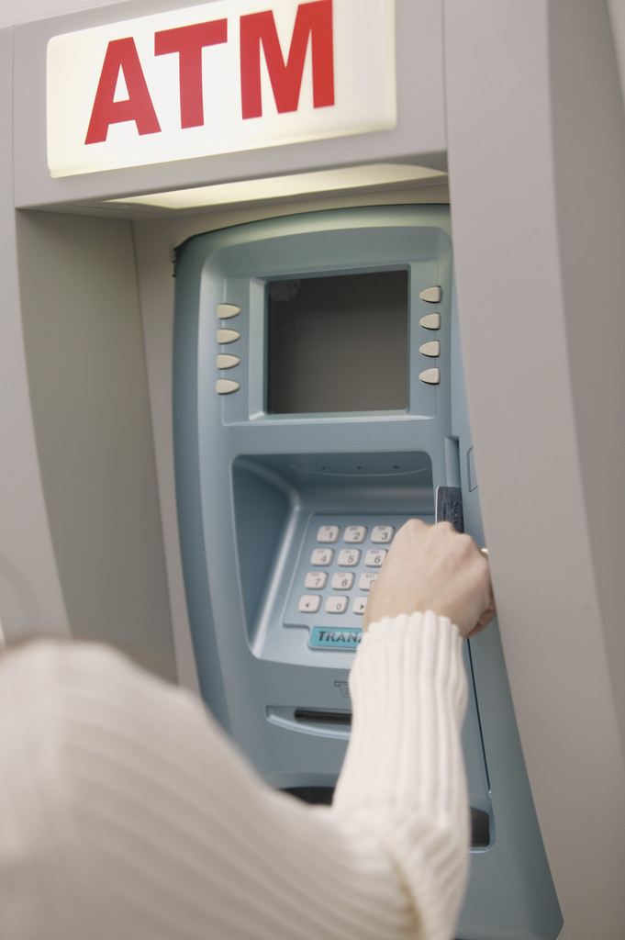
El banco

Slide 9
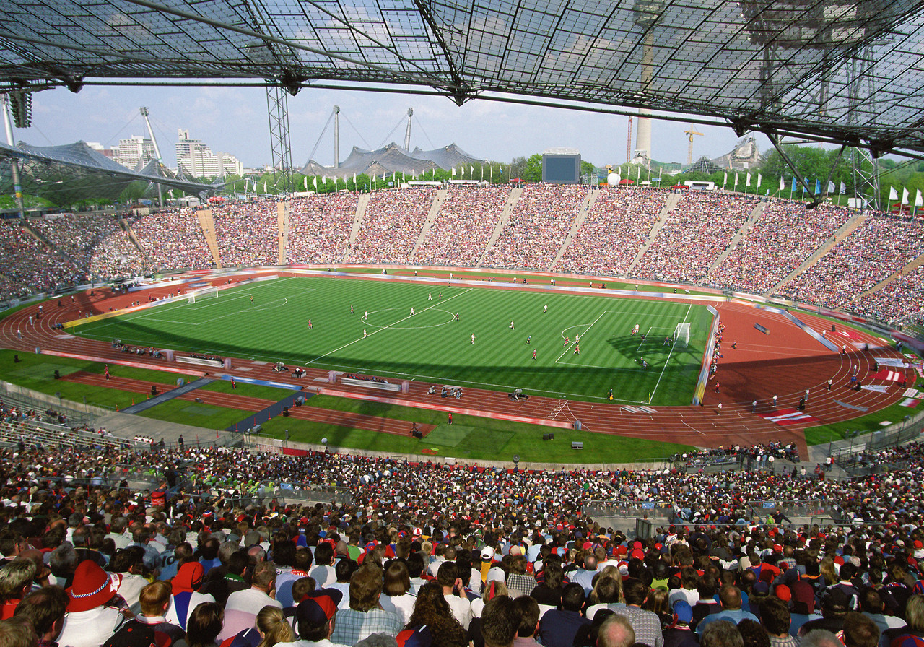
El estadio

Slide 10
El restaurante

Slide 11
El café

Slide 12
La iglesia

Slide 13
La sinagoga

Slide 14
El templo

Slide 15
La mezquita

Slide 16
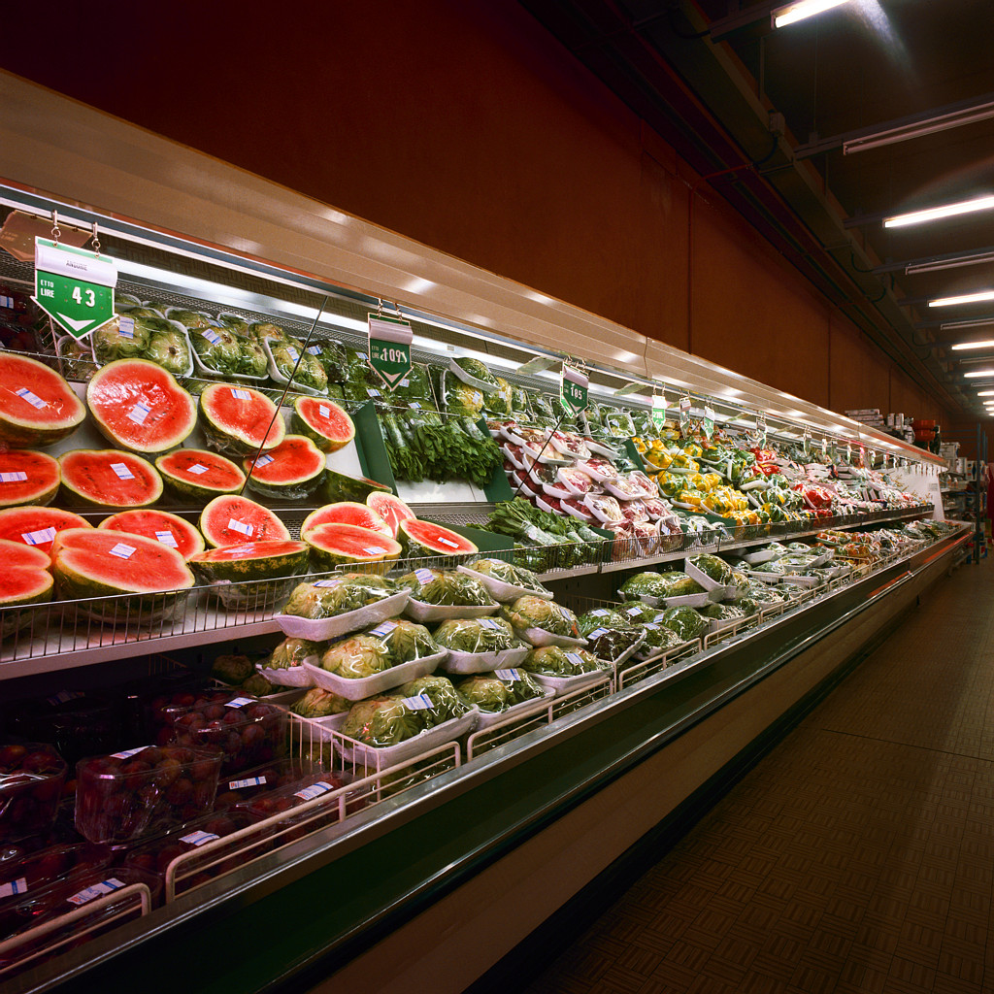
El supermercado

Slide 17
La panadería

Slide 18

El kiosco/ El quiosco

Slide 19
El museo

Slide 20
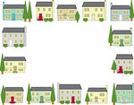
El vecindario

Slide 21
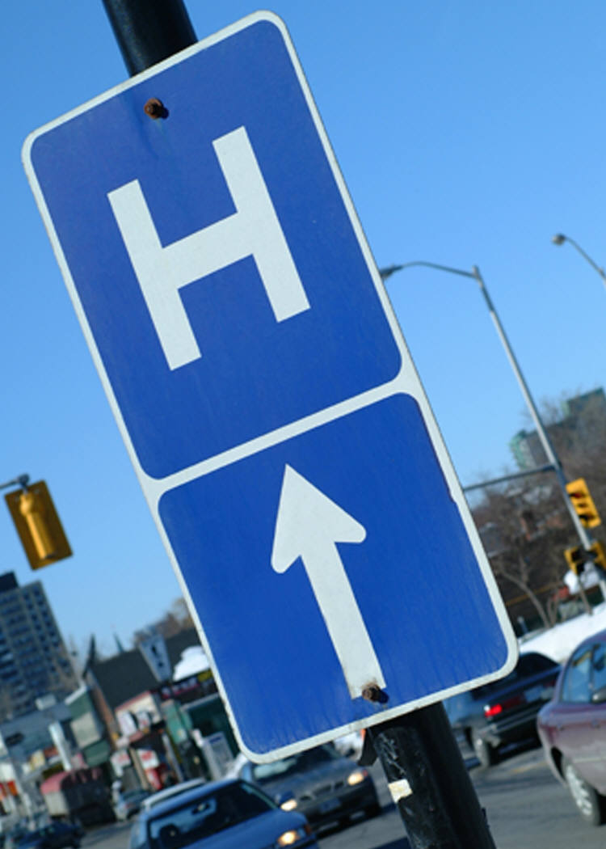
El hospital

Slide 22
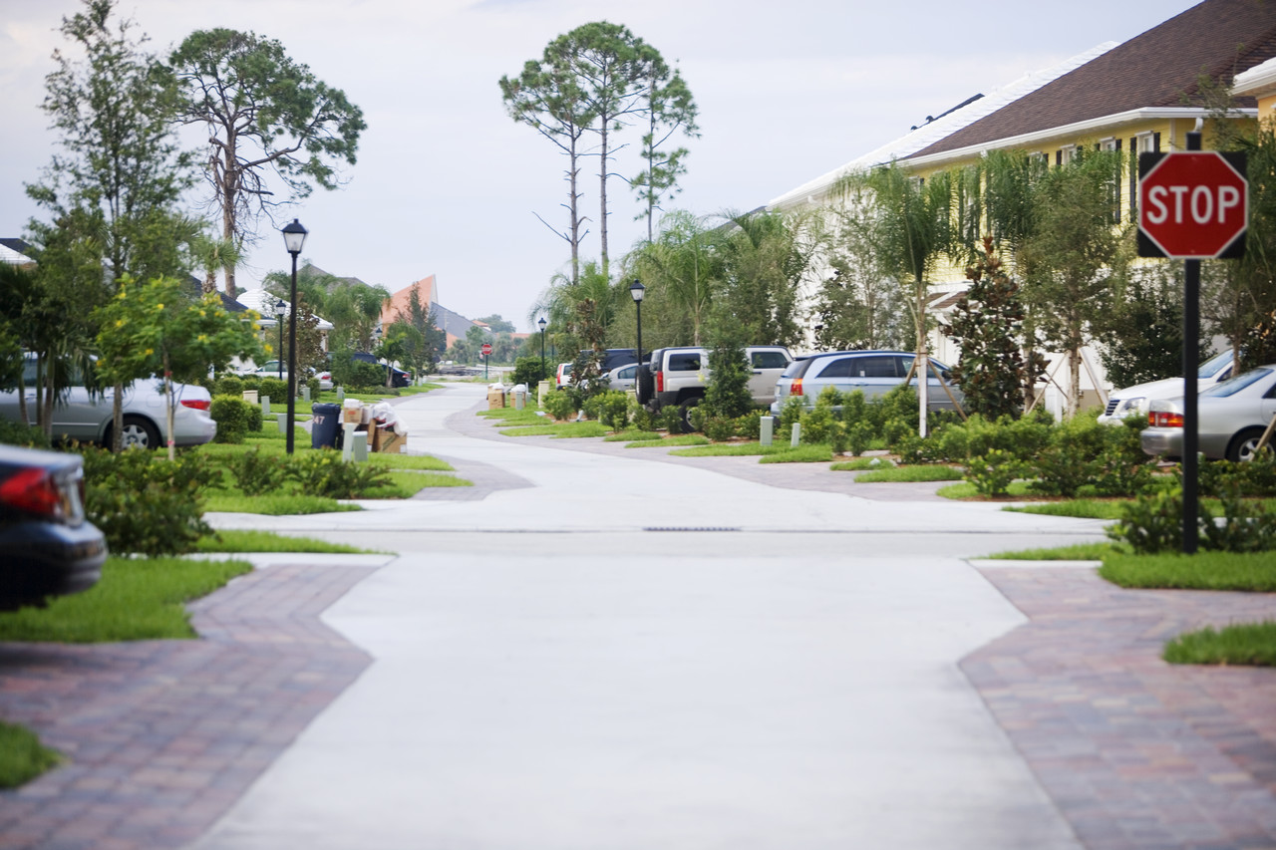
La calle

Slide 23
El club de baile

Slide 24
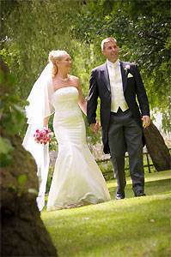
La boda

Slide 25
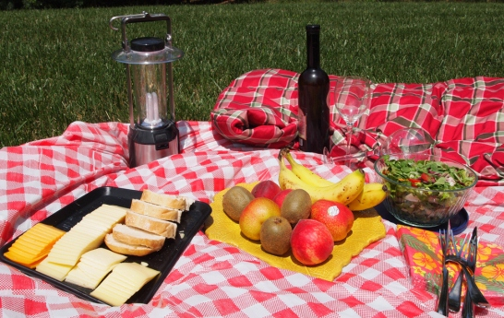
El Picnic

Slide 26
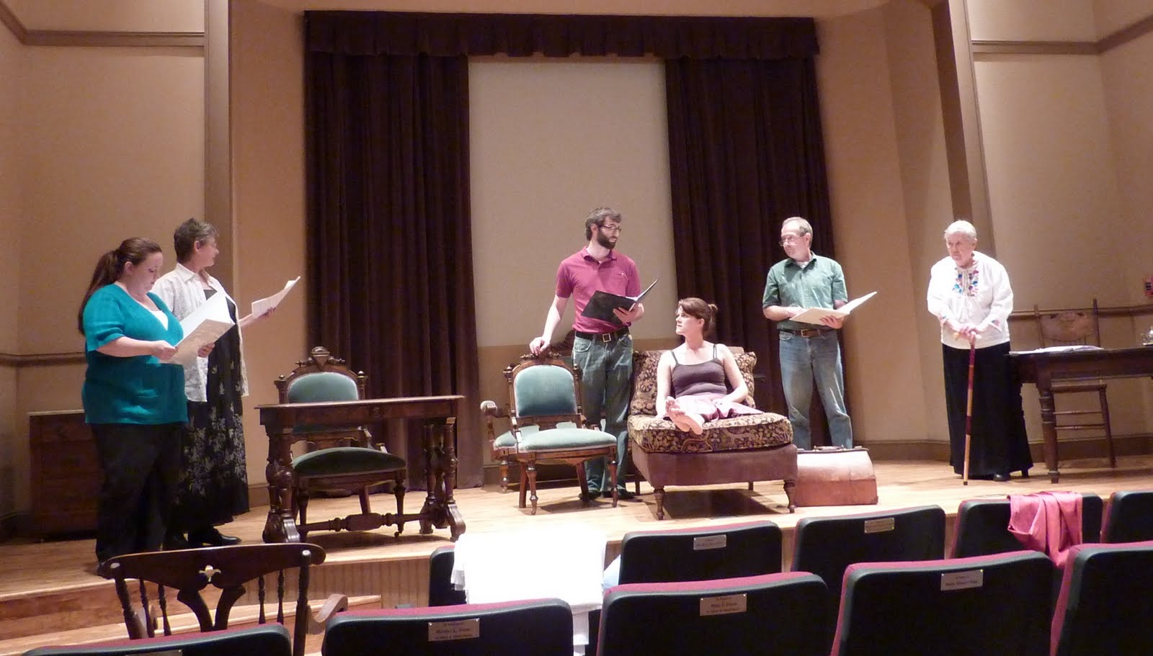
El ensayo

Slide 27
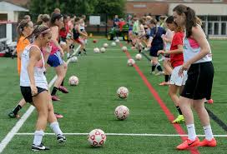
El entrenamiento

Slide 28

La reunión

Slide 29
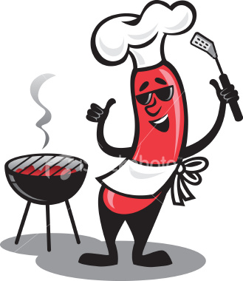
La Barbacoa

Slide 30
Individual City Design
Each person will get one piece of paper. Listen for directions.

Slide 31
Tarea
FINISH YOUR CITY DESIGN IF YOU DID NOT IN CLASS!
MAKE SURE YOUR NAME IS ON THE BACK OF IT!
Study using Quizlet

