Slide 1
TIENEN 5 MINUTOS
Objective:
I can say the preposition rhyme and use directions to figure out where something is located
Vocab/Ideas:
Calle
Doble
Vaya
Camine
Monte
Siga
Cuadra
Vámonos:
Translate the following sentences:
The church is to the left of the synagogue.
The street is near the neighborhood.
The café is between the restaurant and the museum.
The dance club is far from the mosque.

Slide 2
VÁMONOS
The church is to the left of the synagogue.
The street is near the neighborhood.
The café is between the restaurant and the museum.
The dance club is far from the mosque.
La iglesia está a la izquierda de la sinagoga.
La calle está cerca del vecindario.
El café está entre el restaurante y el museo.
El club de baile está lejos de la mezquita.

Slide 3
Quiz - Thursday B-Day Friday A -Day
Prepositions
Places
I need

Slide 4
Places

Slide 5
VOCAB/IDEAS
Our new vocabulary words will be on the top of the slide. If you think you know what the word means, raise your hand. I will call on someone to share the definition.
For each new word, we will need an action. After we have the definition, if you can ACT OUT the word, raise your hand. I will call on someone to share the action with the class. Everyone will do the new action.

Slide 6
¿Cómo llego a…?/ ¿Cómo voy para…? How do I get to?

Slide 7
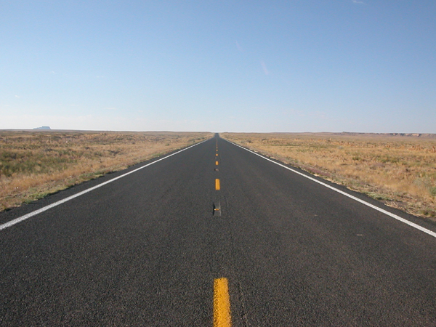
Derecho
Straight
Notes:
Point to your self

Slide 8
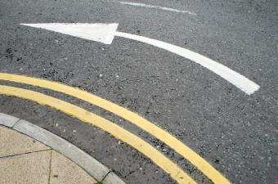
Doble
Turn (command)
Notes:
Tap your head, like you are thinking, and maybe have a puzzled look on your face

Slide 9
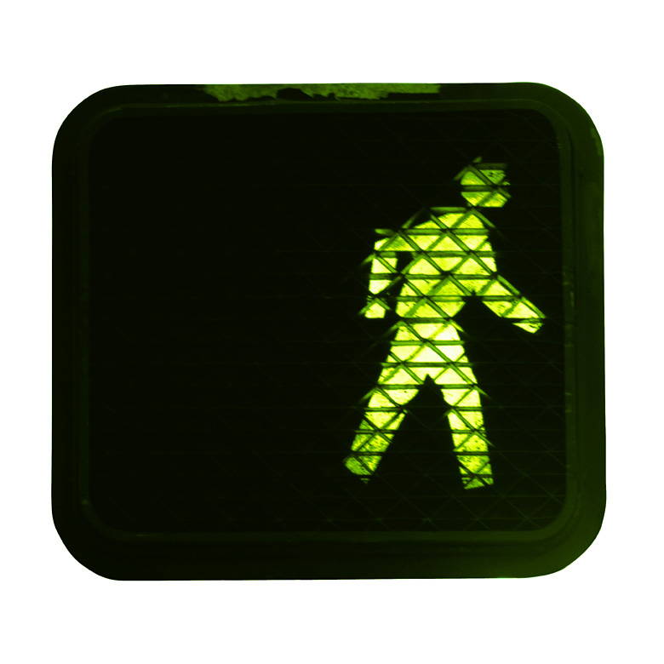
Vaya/Camine
Go/Walk (command)
Notes:
Point to a student in the classroom

Slide 10
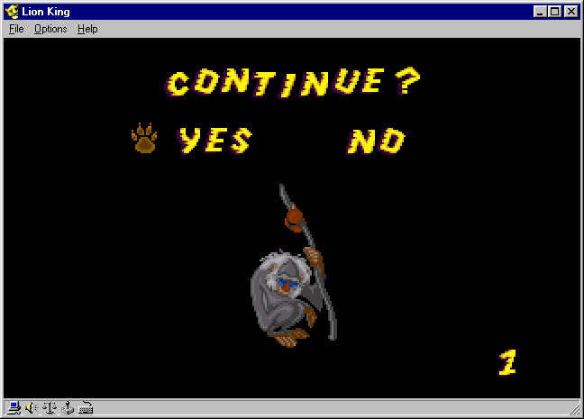
Siga
Continue

Slide 11
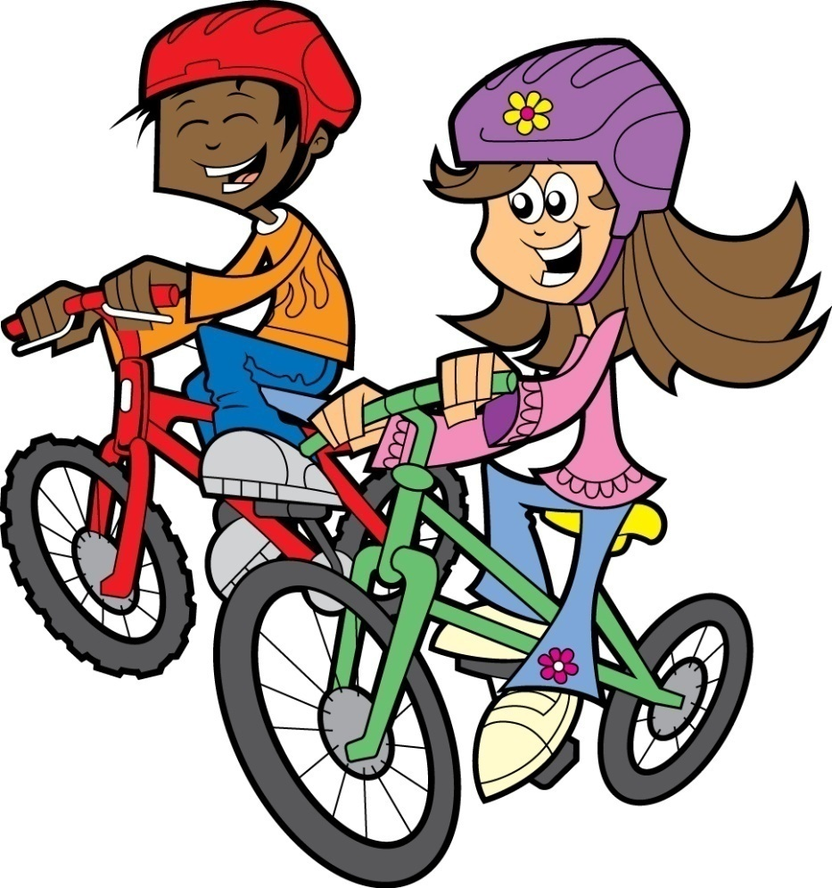
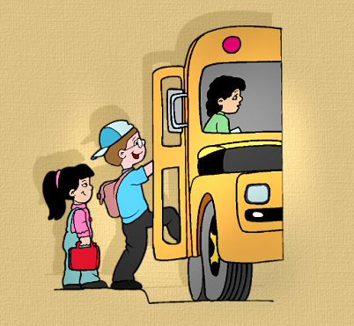
Montar en bicicleta (Monte)
Ride (command)

Slide 12
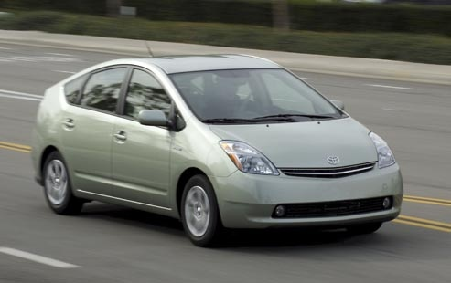
Pasear en carro

Slide 13
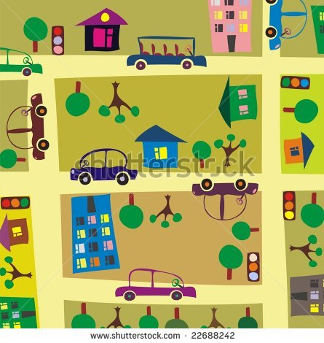
Cuadra
Block (of a street)

Slide 14
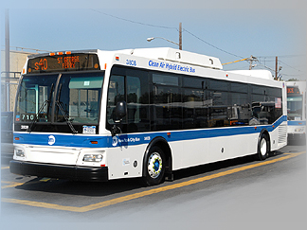
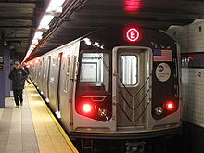
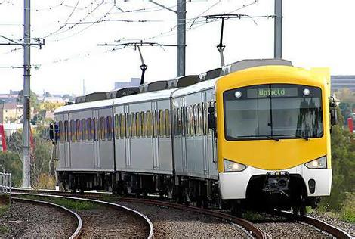
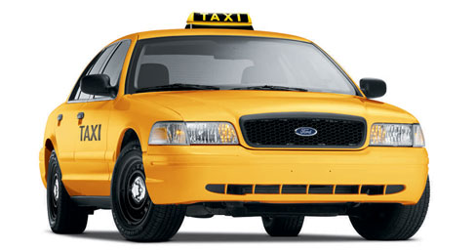
Ir por autobús/metro/taxi/tren
Block (of a street)
Block (of a street)

Slide 15
Spanish Preposition Rhyme
PP

Slide 16
Places Vocabulary
La tienda
El banco
El estadio
El restaurante
El café
La iglesia
La sinagoga
El templo
La mezquita
El supermercado
La panadería
El kiosco
El museo
El vecindario
El hospital
The store
The bank
The stadium
The restaurant
The cafe
The church
The synagogue
The temple
The mosque
The supermarket
The bakery
The kiosk
The museum
The neighborhood
The hospital

Slide 17
Independence Practice

Slide 18
Part I
Using your map and the vocab from today, write directions starting at one place and going to 5 different buildings on your map.
Example:
Empieza en Prince Charming Regal Carosel. Vaya a la derecha. Siga para dos cuadras. Doble a la izquierda cerca de Mad Tea Party. Vaya para una cuadra. Para a la derecha.

Slide 19
Part II
With a partner, talk about where different things are located.
Ask where different buildings are located: ¿Dónde está el/la [place]?
Respond with: [Place] está en la calle [Name of Street]. OR [Place] está [preposition] de [other place]
You need to ask/answer questions for 3 minutes.

Slide 20
Part III
Partner 1: Give your map to your partner. Read them your directions.
Partner 2: Listen to the directions your partner says and write where you end up.

Slide 21
TAREA
If you didn’t turn in your city drawing today- get it done and turn it in!
Study your prepositions
Study the places vocabulary
30 minutes on your homework log!!!

