Slide 1
VÁMONOS 1-3
Escribe la fecha y el objetivo.
In English, describe how you would greet (say hello to) each of the following people. What would you say? What would your body language be?
Your best friend
Your mother/grandmother
A celebrity
Your brother or sister
A stranger
3. Do you greet different people in different ways? Why or why not?

Slide 2
EL OBJETIVO:
(Review)
I can greet people, ask how they are and give a farewell in a polite way

Slide 3
Momento Cultural

Slide 4
Saying “Hello” in Different Cultures:
The ways that we greet and interact with different people depends on our relationships to them, but also on our culture.
The ways that we interact with each other in the US might seem strange—or even inappropriate—to people in other parts of the world.
When we meet people, they not only listen to what we say, but they also “read” what we do (our body language).

Slide 5
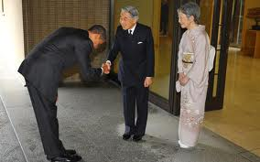
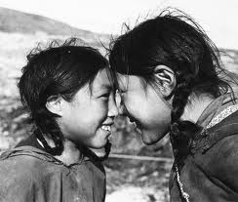
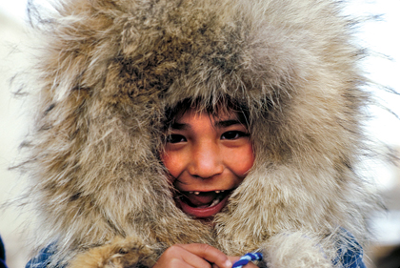
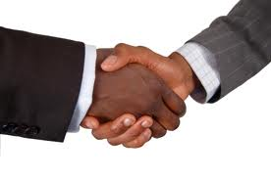
Saying “Hello” in Different Cultures:
Inuit
Japan
Tibet
USA

Slide 6
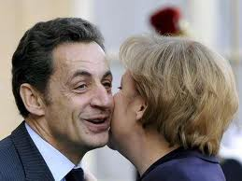
Saying “Hello” in Spain:
First time you meet
someone—handshake
Other times—besos (small
kisses on the cheek);
starting with the left
Many Latin American
Cultures use besos as well—
some use one, others use two
The besos are NOT romantic—they are polite!
Why might it be important to know how people in a culture greet one another before entering that culture?
Spain

Slide 7
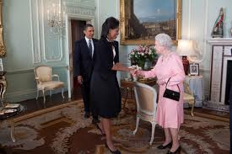
OOPS…
http://www.youtube.com/watch?v=bG7FsJA18vI

Slide 8
Tarea
Each person needs a “homework log”
This unit will last 7 days
Make sure you notice the day of your first test- it is on the board!
Study for at least 15 minutes and record it on your homework log
What could you do to study?

Slide 9
TAREA:
Last Class-Review the alphabet
Today-
Review questions words Vocab
At least 15 minutes

Slide 10
UNIT 1: ¡Nos Acordamos!
This unit we will be reviewing the MOST important things from last year AND mixing in some new stuff to ensure that we are all 100% prepared for our cumulative EOY!
This unit will be FAST-PACED, so it is essential that you put forth 110% effort so that we are on track to meet our Big Goal!

Slide 11
INM: Question Words
Today’s review will be about having conversations with people. Conversations are FULL of questions (and some answers, too). To get us started, we’re going to look at the different question words so that we know what they mean when they come up.

Slide 12
How?

Slide 13
When?

Slide 14
What?

Slide 15
Which?

Slide 16
Where?

Slide 17
From Where?

Slide 18
To where?

Slide 19
How much?

Slide 20
How Many?

Slide 21
Why?

Slide 22
Who?

Slide 23
GP: CANTAMOS!!!
Notes:
https://www.youtube.com/watch?v=rQ4Q8rD5U44
https://www.youtube.com/watch?v=CoXCoBE3VgU
https://www.youtube.com/watch?v=rQ4Q8rD5U44

Slide 24
Question Words Song
Cómo—how; cuándo—when;
Qué—what; dónde—where;
Cuántos—how much;
por qué—why ;
Quién means who’s there!
Note: cuál and the variations of dónde are not included

Slide 25
Greetings & Farewells

Slide 26
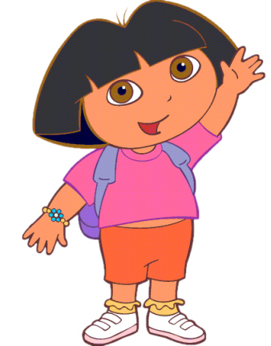
Hola
Hello

Slide 27
Buenos días
Good morning

Slide 28
Buenas tardes
Good afternoon

Slide 29
Buenas noches*
Good evening/night
This can be a greeting OR a goodbye

Slide 30
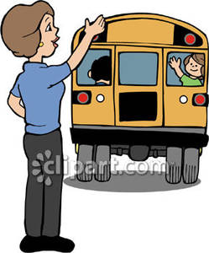
Adiós
Goodbye

Slide 31
Hasta luego / Nos vemos
See you later

Slide 32
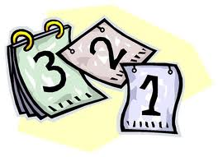
Hasta mañana
See you tomorrow

Slide 33
Tengo que irme
g2g
I have to go!

Slide 34
Buenas noches
Buenos días
Hola
Buenas noches
Adiós
Hasta luego
Buenas tardes

Slide 35
ORIGIN & NAME:

Slide 36
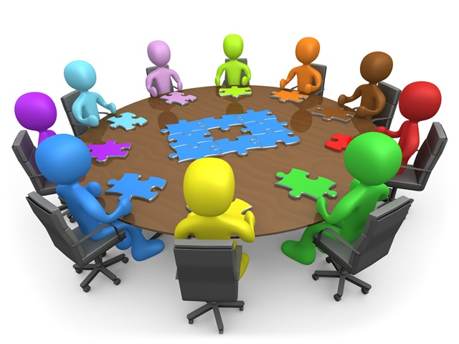
¿Cómo te llamas?
What is your name?

Slide 37
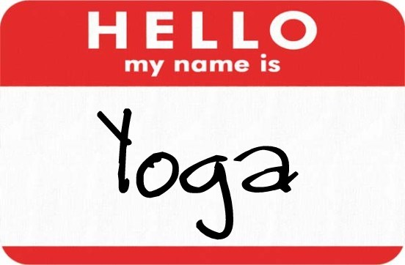
Me llamo…
My name is…

Slide 38
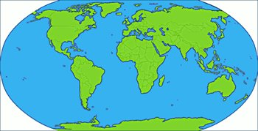
¿De dónde eres (tú)?
Where are you from?

Slide 39
Yo soy de…
I am from…

Slide 40
Let’s see the video
Notes:
http://edtech2.boisestate.edu/baqueron/506/introduction/hello4.html

Slide 41
NEIGHBOR CHAT:
Practice asking and answering the two questions we just learned with the person next to you.
NO ENGLISH!

Slide 42
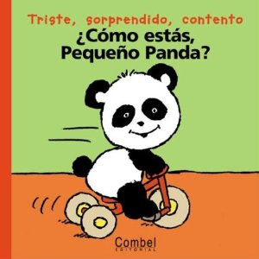
¿Cómo estás (tú)?
How are you?

Slide 43
Yo estoy (muy) bien.
I am (very) good.

Slide 44
Yo estoy así así /
más o menos.
I am okay.

Slide 45
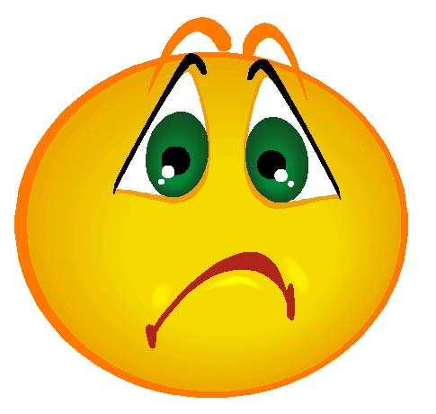
Yo estoy (muy) mal.
I am (very) bad.

Slide 46
¿Qué diría la persona?
What would the person say if asked how they were feeling/doing?

Slide 47
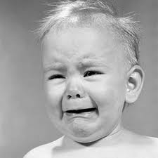
¿Cómo estás?
Estoy mal

Slide 48
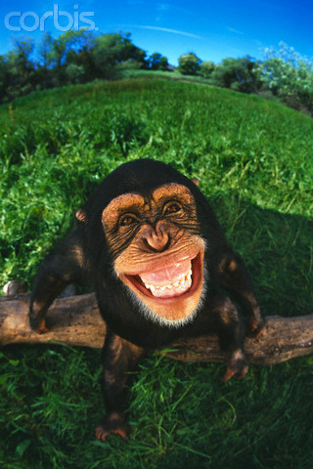
¿Cómo estás?
Estoy bien

Slide 49
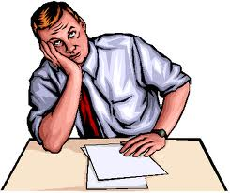
¿Cómo estás?
Estoy así así

Slide 50
Extras!

Slide 51
Mucho gusto
Nice to meet you

Slide 52
Igualmente
You too

Slide 53
Qué tal?
How’s it going?

Slide 54
Descubre
Listening Practice

Slide 55
Choose the correct response
1. a. Muy bien, Gracias B. Me llamo Graciela
2. a. Lo siento B.Mucho Gusto
3. a. Soy de Puerto Rico B. No muy bien
4. a. No hay de qué B.Regular
5. a. Mucho Gusto B. Hasta Pronto
6. a. Nada B. Igualmente

Slide 56
GP: Work with a classmate to put this scrambled conversation in order

Slide 57
Scrambled Conversation
Muy bien, Gracias. Soy Rosabel
Soy del Ecuador. Y tu?
Mucho Gusto, Rosabel
Hola…Me llamo, Carlos. Como estas?
Soy de Argentina
Igualmente. De donde eres, Carlos?

Slide 58
IP: Complete the following exchanges.

Slide 59
Buenos dias ¿De donde eres? De nada ¿Que Pasa? Hasta Luego ¿Que tal? ¿Como te llamas? Encantado (a) Muy bien, Gracias
A.1___________________
2. Buenos dias, ¿Qué tal?
__________________
Me llamo Carmen
1. _________________
2. Soy de Canada
Te presento a Marisol
__________________
Gracias
___________________
1. _________________
2. Regular
1.____________________
2. Nada
1.¡Hasta la vista!
2.____________________

Slide 60
EXIT TICKET: answer the following in complete spanish sentences
¿Cómo te llamas?
¿De dónde eres?
¿Cómo estás?
¿Qué tiempo hace?
¿Cuántos años tienes?

