Slide 1
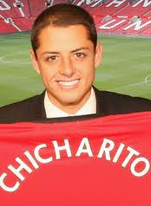
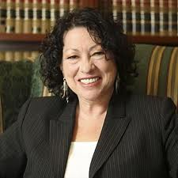
VÁMONOS 1-4
Escribe la fecha y el objetivo.
Write each question and then respond in a complete, Spanish sentence.
¿Cómo te llamas?
¿Cómo estás?
¿De dónde eres?
¿Cómo se llama él?
¿De dónde es Sonia Sotomayor?
(New York City)

Slide 2
El objetivo
(Review)
Grammar-review

Slide 3
Momento Cultural
Español es increíble porque…

Slide 4
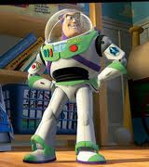
It can be hilarious and entertaining!
Just ask Buzz… ☺
Notes:
http://www.youtube.com/watch?v=3s2wbe9zSbs

Slide 5
Tarea
Review today’s vocabulary

Slide 6
Last class

Slide 7
Me llamo
Buenas
tal
bien
gracias
tú
Hasta
pronto
mañana

Slide 8
Comic Strip
Today you will create a Comic strip to practice last class vocabulary
Your Comic Strip Must Include:
2 greetings
2 farewells
What’s your name? (Q&A)
How are you? (Q&A)
Where are you from? (Q&A)
3 “extras”—ANY previous vocabulary

Slide 9
LOS PRONOMBRES

Slide 10
¿QUÉ ES UN PRONOMBRE?
The subject of a sentence is the person, place, or thing being described or performing an action.
(EX 1) Mariana runs. → Who runs? → Mariana (subject)
(EX 2) Science class is hard. → What’s hard? → Science (subject)
A subject pronoun can replace a subject.
(EX 3) Jose is funny. →He is funny.
(EX 4) The girls are smart. →They are smart.
(EX 5) Mom and I go to the mall. →We go to the mall.

Slide 11
THE VERB CHART!
Each subject pronoun has a special “spot” on the verb chart that never, ever moves!
ENGLISH:
I | We
You (informal) | Y’all (in Spain)
He She You (formal) | They You all (formal)
SPANISH:
Yo | Nosotros
Tú | Vosotros
Él Ella Usted | Ellos Ellas Ustedes
=
Mi pizarra
Tupapel

Slide 12
FORMAL vs. INFORMAL
Based on what you remember from last year, write down 3 examples each of people you would address formally and informally.

Slide 13
=
1 minuto—copiar
Después, discutimos
Mi pizarra
Tu papel
you
informally
you
formally
you all
informally
Spain
you all
informally
formally
they
boys
boys
girls
they
girls

Slide 14
Formal YOU vs. Informal YOU?
FORMAL
INFORMAL
Usted y ustedes
Tú y vosotros
Parents
Grandparents
Teachers
Authority figures
Anyone OLDER than you
Younger brothers/sisters
Cousins
Friends
Anyone YOUNGER than you

Slide 15
¡PRACTICAMOS!
.
With the person next to you (volume = 2), complete the FIRST HALF of each problem set. The other half will be tarea.

Slide 16
DO NOW
TAREA

Slide 17
Usted
Tú
Vosotras
Ustedes
Vosotros
Usted
1. Ellas
2. Ellos
3. Ellos
4. Yo
5. Ella
Ustedes
Él
Nosotros
Ellos
Ella
Vosotros
DO NOW

Slide 18
EL VERBO: SER

Slide 19
SER = TO BE
Changing a verb to match its subject is called conjugating.
SER means to beand is one of the most important verbs in Spanish!
You must conjugate SER to the subject you are talking about.

Slide 20
SER = TO BE
soy
somos
eres
sois
es
son

Slide 21
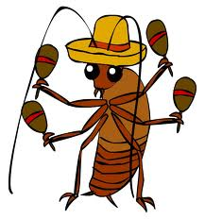
¡CANTAMOS!
Yo soy, tú eres
Yo soy, tú eres
Él, ella, ustedes
Nosotros somos
Vosotros sois
ellos, ellas, ustedes son

Slide 22
EJEMPLOS
Now we are going to work on examples 1-20. We will do the first 5 together, you will do the second 5 with your partner, and the last 10 independently.

Slide 23
EJEMPLOS
soy
1. Yo de los EstadosUnidos.
2. María de El Salvador.
3. Ellos de Perú.
4. Maya y yo amigas.
5. Luis, Pedro, y tú de Puerto Rico
es
son
somos
sois

Slide 24
EJEMPLOS
eres
6. ¿De dónde tú?
7. Tú de México.
8. Mariana de Costa Rica.
9. Ellos atléticos.
10. Nosotros estudiantes.
eres
es
son
somos

Slide 25
EJEMPLOS
son
son
sois
soy
es
soy
son
somos
son
es

Slide 26
MINUTO LOCO
Abren los libros a la página 50.
You will have 3 ½ minutes to see how many Spanish pronouns you can translate into English.

