Slide 1
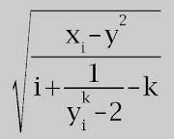
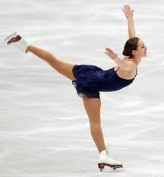
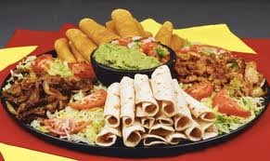
VÁMONOS (2-1)
Escribe la fecha
Look at the pictures below. In Spanish, create 5 complete sentences (2 for each foto) saying whether you like or dislike the things pictured.
A
C
B
D
E

Slide 2
TAREA:
Practice today’s vocabulary using Quizlet
Examen (Test)
Next Monday
Septiembre 14-A
15-B

Slide 3
MOMENTO “CULTURAL”
Celebrating the Hispanic Heritage Month
Studying Spanish is AWESOME because…

Slide 4
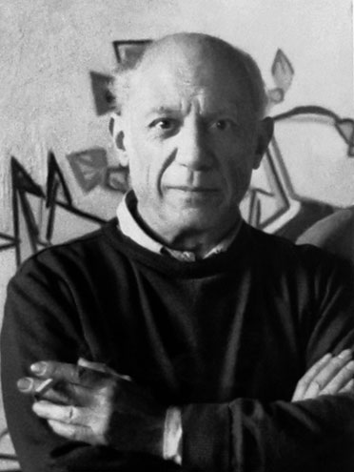
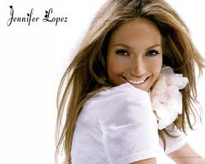
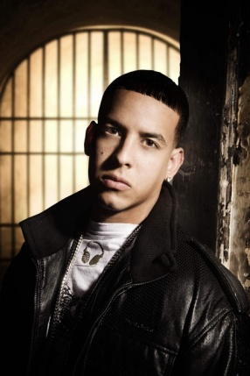
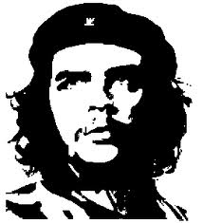
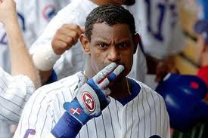
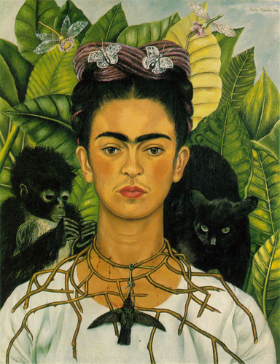
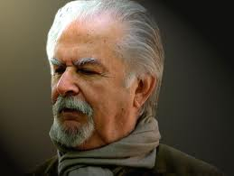
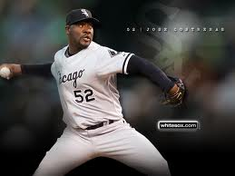
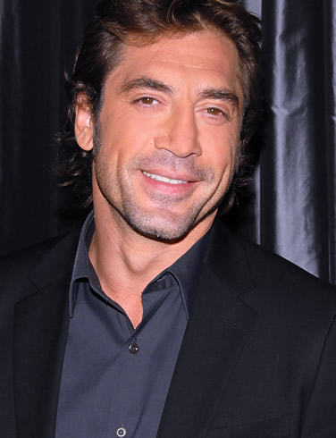
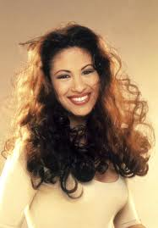
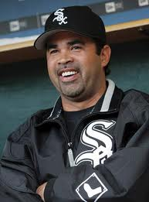
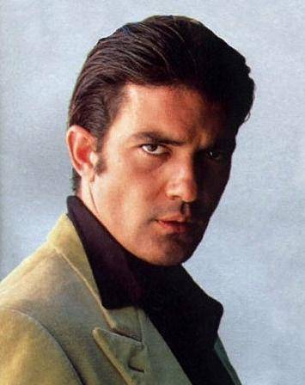
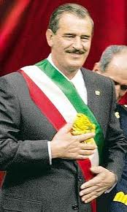
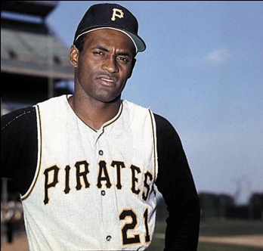
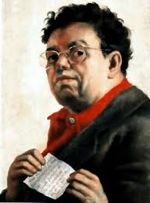
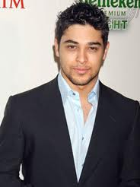
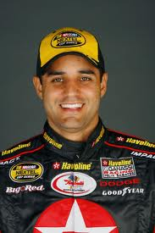
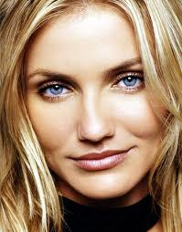
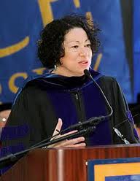
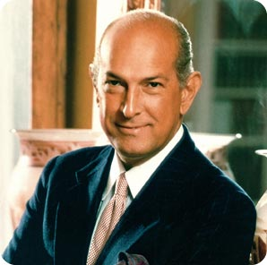
TONS OF CELEBRITIES SPEAK A 2ND LANGUAGE!
Notes:
http://www.youtube.com/watch?v=y1YU0KOGHuQ

Slide 5
El OBJETIVO
I can describe my likes and dislikes and my free time activities

Slide 6
Mi tiempo Libre –Vocabulario Repaso
Notes:
Review the worksheet

Slide 7
Video: Las cosas que me gustan

Slide 8
Charades
One person due the action
The rest of the group write the Pasatiempo in the white board

Slide 9
Crear las preguntas
¿Te gusta…..?
Prefieres

Slide 10
A practicar- Speaking

