Slide 1
VÁMONOS 1-3 Tienen 5 Minutos
Objective:
I can describe reasons to study Spanish and say where I’m from,
Vocab/Ideas
Soy de…
¿De dónde eres?
Vámonos:
1.What was Frida Kahlo known for? Describe her style.
2. Describe the city of Toledo? Why was it built this way?
3. What novel was Miguel de Cervantes famous for writing?

Slide 2
Start inVámonos
1.Escribe la Fecha y el objetivo
Get in groups and star working on this activity:
You are to create a mini poster to represent YOUR GROUP’S reasons for taking Spanish.
Draw pictures to represent things that motivate you and things that you hope to accomplish in your life by learning Spanish.
Posters should be colorful and well presented. They should not contain just lists of words, but images that represent your ideas. Your final product will be presented and will be put into your Spanish folder as one of your first entries.

Slide 3
It’s Your Turn!
With your partner, create a one-page advertisement that explains why it’s important to study Spanish.
Use what you learned today
I will put the best ads up on our bulletin board!
Start looking for opportunities to use Spanish in your everyday life.

Slide 4
EL OBJETIVO
I can describe reasons to study Spanish, say where I’m from, and sing the countries and capitals song

Slide 5
Let’s know each other better

Slide 6
Momento Cultural
Español es increíble porque…

Slide 7
It can be hilarious and entertaining!
Just ask Buzz… ☺
Notes:
http://www.youtube.com/watch?v=3s2wbe9zSbs

Slide 8
Why studying Spanish?
MINI-POSTER PRESENTATION

Slide 9
Presentaciones
I will call on volunteers to present their mini-posters to the class (everyone will turn them in-but you do not have to present)
While others are presenting, I want you to take notes in your packet like this:
Names of Presenters | Reasons for Studying Spanish
Write your classmates’ name
Write at least one reason they give

Slide 10
INM: WHERE ARE YOU FROM?
¿DE Donde eres?

Slide 11
¿De dónde eres?
To ask someone where they are from, you will use the expression:
¿De dónde eres?
To answer someone when asked where you are from you will use the expression:
Yo soy de…(place)
Useful places:
North Carolina = Carolina del Norte
The United States (USA) = Los Estados Unidos (EEUU)

Slide 12
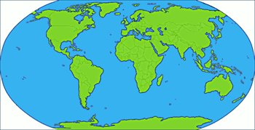
¿De dónde eres (tú)?
Where are you from?

Slide 13
Yo soy de…
I am from…

Slide 14
A practicar

Slide 15
¿De dónde eres, Jay Z?
Yo soy de Nueva York.

Slide 16
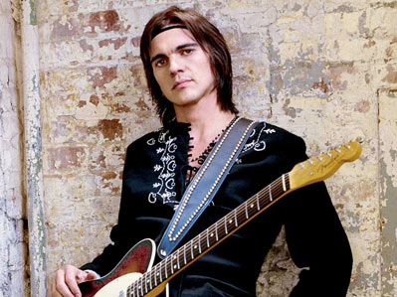
¿De dónde eres, Juanes?
Yo soy de Colombia.

Slide 17
¿De dónde eres, Beyonce?
Yo soy de Tejas.

Slide 18
¿De dónde eres, Barack?
Yo soy de Hawái.

Slide 19
¿De dónde eres, Oprah?
Yo soy de Misisipi.

Slide 20
¿De dónde eres tú?
Notes:
Throw around a stuffed animal!

Slide 21
Yo soy de Puerto Rico.

Slide 22
GP: Tira la pregunta!
We are going to play a QUICK GAME with the new QUESTIONS we’ve learned. I will start by throwing the ball to a person and asking them one of three questions:
- ¿Cómo te llamas?
Me llamo
- ¿De dónde eres tú?
Yo soy de…
- ¿Cómo estás?
Estoy…
You MUST answer in Spanish, then throw the animal to a NEW person and ask them a DIFFERENT question. I will set a TIMER and whoever has the animal when the timer RUNS OUT will get extra TAREA!!!
Notes:
Kind of like hot potato, but just practicing the questions. I say let’s make this a 5 minute activity, tops. If it is not going well, then just cut it and move on. Set the timer for maybe a minute thirty the first round, a minute the second, and 45 the third. 3 rounds should be fine.

Slide 23
Entrevistas
Estudiante | Respuesta
Example: #1: María | Example: Nueva York
#2:
#3:
#4:
#5:
#6:
#7:
#8:
#9:
#10:
You will be interviewing your classmates to find out where they are from
You will ask your classmates, “¿De dónde eres?” and they will respond “Yo soy de…”. Then you will switch roles
You will ask 10 classmates and record your responses in the chart in your packet
Recuerdan: No ENGLISH!
Use your appointment Pair work

Slide 24
Start in Class/Tarea
Bar graph
You will take the data from your entrevistas and create a bar graph to show where the estudiantes you talked to are from (in your carpeta)
Make sure your graph is clearly labeled with its different sections, the x and y axis are labeled and it has a title

Slide 25
EXIT SLIP
Translate the following.
¿Cómo estás?
¿De dónde eres?
I’m (doing) bad.
I am from Charlotte.

Slide 26
Participación y Reflección
Fill out your participation reflection in your carpeta to get your stamp!

