Slide 1
Vámonos: Tienen 5 Minutos
Objective:
I can greet someone appropriately and tell them how I am doing
Vocab/Ideas:
Hola
Buenos días
Buenas tardes
Buenas noches
Adiós
Hasta Luego
¿Cómo te llamas?
Me llamo
¿Cómo estás?
Yo estoy bien.
Yo estoy más o menos.
Yo estoy mal.
Mucho gusto.
Igualmente
Vámonos:
Write a sentence telling me you are from the capital of Venezuela.
Write a sentence telling me Sarah (she) is from the capital of Uruguay.
Write a sentence telling me that we are from the United States.
Write a question asking someone else where they are from.
Warm-Up
In your packet, write down the fecha, the objective and answer the vámonos questions.

Slide 2
BASIC CONVERSATIONS
Introductions and Greetings

Slide 3
EL OBJETIVO:
I Can greet someone appropriately and tell them how I am doing

Slide 4
Let’s know each other better

Slide 5
15 de septiembre – 15 de octubre

Slide 6
Momento Cultural

Slide 7
Saying “Hello” in Different Cultures:
The ways that we greet and interact with different people depends on our relationships to them, but also on our culture.
The ways that we interact with each other in the US might seem strange—or even inappropriate—to people in other parts of the world.
When we meet people, they not only listen to what we say, but they also “read” what we do (our body language).

Slide 8
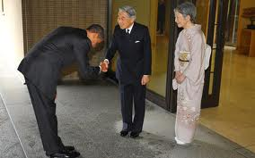
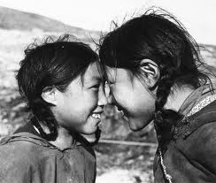
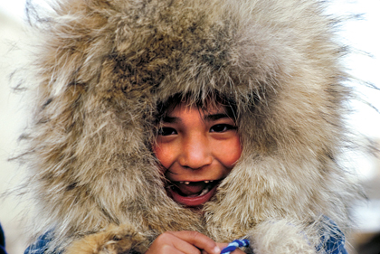
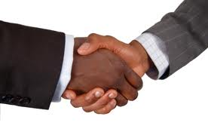
Saying “Hello” in Different Cultures:
Inuit
Japan
Tibet
USA

Slide 9
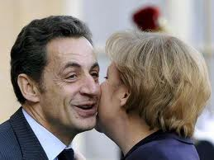
Saying “Hello” in Spain:
First time you meet
someone—handshake
Other times—besos (small
kisses on the cheek);
starting with the left
Many Latin American
Cultures use besos as well—
some use one, others use two
The besos are NOT romantic—they are polite!
Why might it be important to know how people in a culture greet one another before entering that culture?
Spain

Slide 10
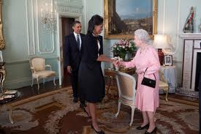
OOPS…
http://www.youtube.com/watch?v=bG7FsJA18vI

Slide 11
INM:Greetings & Farewells

Slide 12
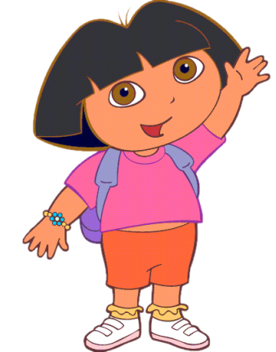
Hola
Hello

Slide 13
Buenos días
Good morning

Slide 14
Buenas tardes
Good afternoon

Slide 15
Buenas noches*
Good evening/night
This can be a greeting OR a goodbye

Slide 16
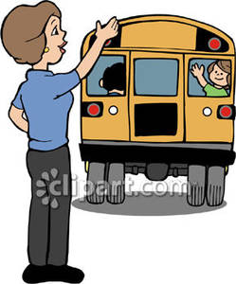
Adiós
Goodbye

Slide 17
Hasta luego
See you later

Slide 18
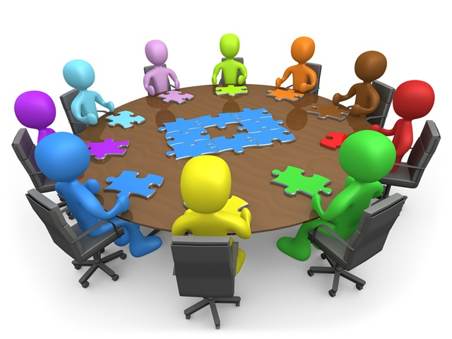
¿Cómo te llamas?
What is your name?

Slide 19
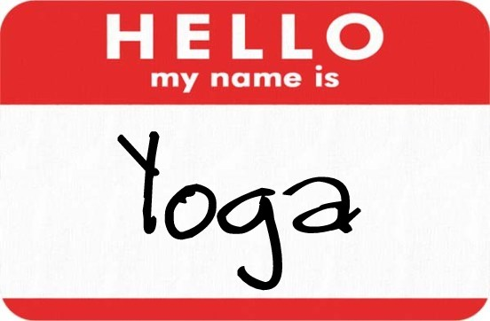
Me llamo…
My name is…

Slide 20
Repaso: Tira la pelota
We are going to play a FUN review game!
2 teams
1 member throws ball at board and hits TPR Vocabulary Picture.
The person who is OPPOSITE them, on the other side of the room has 3 seconds to say the word and do the motion.
If he or she cannot remember the motion or the word, the person that threw the ball can STEAL and get a point.
Whichever team answers the question correctly gets the point, and then the other team will tira la pelota.
We will play to 5 points!

Slide 22
INM: MORE Introductory Convo!!!

Slide 23
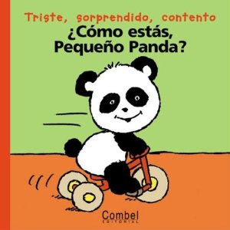
¿Cómo estás (tú)?
How are you?

Slide 24
Yo estoy (muy) bien.
I am (very) good.

Slide 25
Yo estoy así así /
más o menos.
I am okay.

Slide 26
Yo estoy (muy) mal.
I am (very) bad.

Slide 27
Mucho gusto
Nice to meet you

Slide 28
Igualmente
You too

Slide 29
¿Qué diría la persona?
What would the person say if asked how they were feeling/doing?

Slide 30
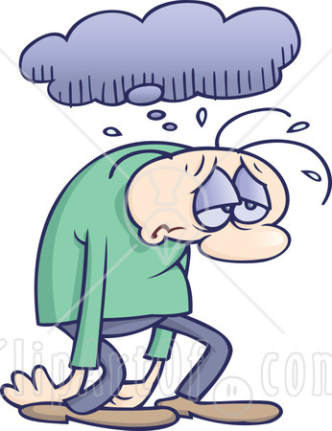
¿Qué dirá la persona?
Estoy mal.

Slide 31
¿Qué dirá la persona?
Estoy bien.

Slide 32
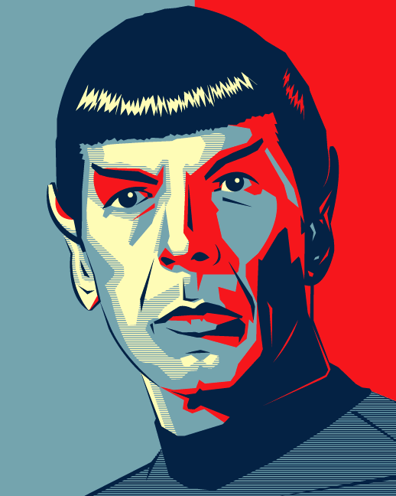
¿Qué dirá la persona?
Estoy así así.

Slide 33
¿Cómo estás tú?
Notes:
Throw around a stuffed animal and ask this!

Slide 34
Yo estoy bien!!!

Slide 35
Group Practice
You need to pick a celebrity that you are going to pretend to be. I will give you 1 minute to pick your celebrity and write down the name.
You will be going around the room and introducing yourself to other celebrities. Make sure to politely introduce yourself, say that you are please to meet the other person, and ask and answer how the other person is.
Record the responses in your carpeta.

Slide 36
Example
“Hola, me llamo Shakira. ¿Cómo te llamas?”
“Mucho gusto Shakira, me llamo Marc Anthony. ¿Cómo estás?”
“Igualmente. Yo estoy así así. ¿Cómo estás?”
“Yo estoy muy bien. Buenas tardes”
You should talk to at least 5 people. Make sure to record your responses (who you talked to, how they were doing) in your carpeta
NO ENGLISH!
Notes:
http://edtech2.boisestate.edu/baqueron/506/introduction/hello4.html

Slide 37
Individual Practice
Write out the conversations that you had today like they were a script for a movie that someone else could act out. Include all introductions, questions, goodbyes, etc. in your carpeta

Slide 38
Act it Out!
I will now be asking for volunteers:
One person will provide the scene
2 people will actout the scene
BONUS: When other people are acting make sure to write down places they need to work on their grammar or pronunciation!

Slide 39
Tarea
Test next class period!
Countries and Capitals of South America
How to ask and answer where you are from
How to say someone else is from somewhere
How to introduce yourself
How to greet someone
Green sheet expressions

