Slide 1
VÁMONOS
Answer the following questions:
When is Hispanic Heritage Month?
What is the purpose of Hispanic Heritage Month?
Who are some famous Hispanics?
Why is important to celebrate diversity in the U.S.?

Slide 2
EL OBJETIVO
I can talk about Spanish speaking countries, culture and people.

Slide 3
Anuncios
Dispersal work
Quizlet
Latin American Festival
Project Due- Monday, October 13 and Test

Slide 4
15 de septiembre – 15 de octubre

Slide 5
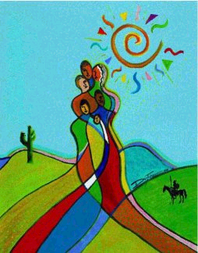
Speak Up for HISPANIC HERITAGE

Slide 6
Hispanic Heritage Month is a national holiday in the USA. It is celebrated from September 15th to October 15th.

Slide 7
It is a time for all of us to remember the contributions of Hispanic-Americans.

Slide 8
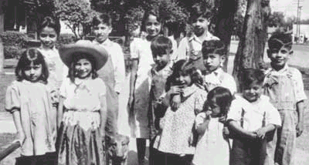
Hispanic-Americans are Spanish-speaking people who have come to make the United States their home.

Slide 9
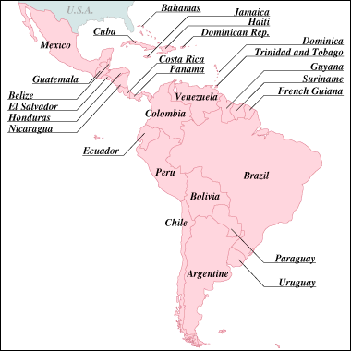
The word “Hispanic” describes people who come from Spanish- speaking countries...

Slide 10
Many Hispanics in the United States came from nearby places, like Mexico, Cuba, Central America, or South America.

Slide 11
But don’t forget that Spanish-speaking people settled in the USA long before the English settled along the eastern coast...

Slide 12
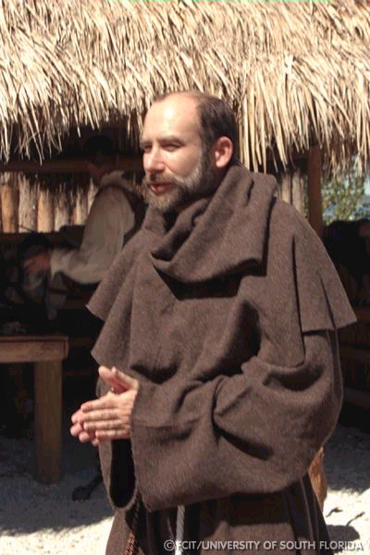
Missionaries from Spain traveled among Native Americans in present-day California and New Mexico...

Slide 13
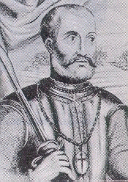
Spanish explorers traveled throughout present-day Florida almost 400 years ago!

Slide 14
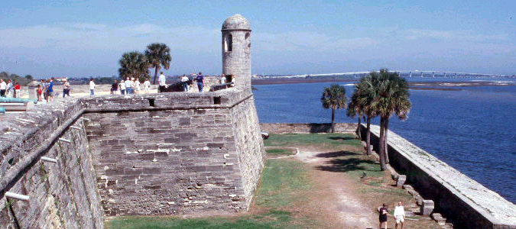
In fact, the oldest city in the United States is St. Augustine, Florida, built by Spanish-speaking settlers...

Slide 15
And the rest of our history is full of famous leaders who were Hispanic!

Slide 16
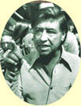
One important Hispanic was Cesar Chavez, a migrant farm worker who worked for fair treatment of Mexican workers on American farms.
Notes:
https://www.youtube.com/watch?v=CtDUTt8ggeA

Slide 17
Hispanic people continue to serve as leaders in all fields today...

Slide 18
“All Americans, regardless of national origin, celebrate the vibrant Hispanic-American spirit that influences our Nation.” President of the United States

Slide 19
HISPANIC HERITAGE MONTH

Slide 20
VIDEOS: Hispanic Heritage Month
We are going to watch 2 videos on Hispanic Heritage Month. As you watch, you will fill in the graphic organizer below with information.

Slide 21
H.H.M. Graphic Organizer:
Who?
What?
Where?
Hispanic Heritage Month
Why?
When?
How?
Notes:
http://www.youtube.com/watch?v=fkDs78DsqH8&feature=related
Hispanic Heritage Month
http://www.youtube.com/watch?v=hMxvZy8JpHA
Obama

Slide 22
Signature Search
Notes:
Hand out (1) name assignments and (2) signature search handout

Slide 23
Signature Search
Each student will be assigned a famous Hispanic person. For the purposes of this activity, you ARE that person.
Read about your famous Hispanic.
We will walk around the class and “meet” different Hispanic people and discover the reasons they are famous.
You will walk around the room and ask people if the identity they received matches the facts below.
If they say “YES,” ask them their identity name and write it in the appropriate box.
If they say “NO,” you may ask them one more time before moving on to another person. You can come back to them later.
You must be standing at ALL times.
Only YOU can write on your paper.
The first one to get all 12 signatures WINS!
Your conversations will look like this…

Slide 24
Signature Search
A:Are you an American farm worker of Mexican descent, labor leader, and civil rights activist? B: Si, Yo Soy (Yes, I am!) A: Mucho Gusto.. ¿Cómo te llamas? Nice to meet you! What’s your name? B: Me llamo César Chávez My name is César Chávez. A: Escribe “César Chávez”en el papel | B: No, No soy No, I’m not. A: Are you a Mexican actor who played Che Guevara in the blockbuster hit, The Motorcycle Diaries? B: Si, Yo soy Yes, I am! Continue with conversation on left.
Notes:
This example is on students’ papers as well

Slide 25
Project
Notes:
Hand out (1) name assignments and (2) signature search handout

Slide 26
Why are we doing this project?
1. Part of learning Spanish is learning about Spanish-speaking cultures and people.
2. We are celebrating Hispanic Heritage Month (Sept. 15-Oct. 15)!
3. Research is a skill that you will need in middle school, high school, and college.

Slide 27
Hispanic Heritage Month MINI-PROJECT
You will received a Project Description

Slide 28
Look at the list of famous Hispanics that you may research.
Circle 3 people you would be interested in researching.
At the bottom of your paper, fill in the blank with the one person you will be researching.
You must have a final decision before the end of the class

Slide 29
Media Center: Your Research Findings
You will:
Research your person using multiple sources (Internet, book, magazine, etc.)
Write ALL of your research notes on your “My Findings” worksheet.
Make sure that all information is neat and complete because you will use this research to complete your project.

Slide 30
Your Research Findings
After you have completed your research, you will:
Choose one option from the project choice board to complete
You will use your research notes to help you complete this.
You may start this on class), but most likely it will be done at home as homework
I expect HIGH quality projects!
SI, SE PUEDE!!!!!!!

Slide 31
How will you be graded?
You will grade yourself and I will grade you in the following categories:

